Slide 1
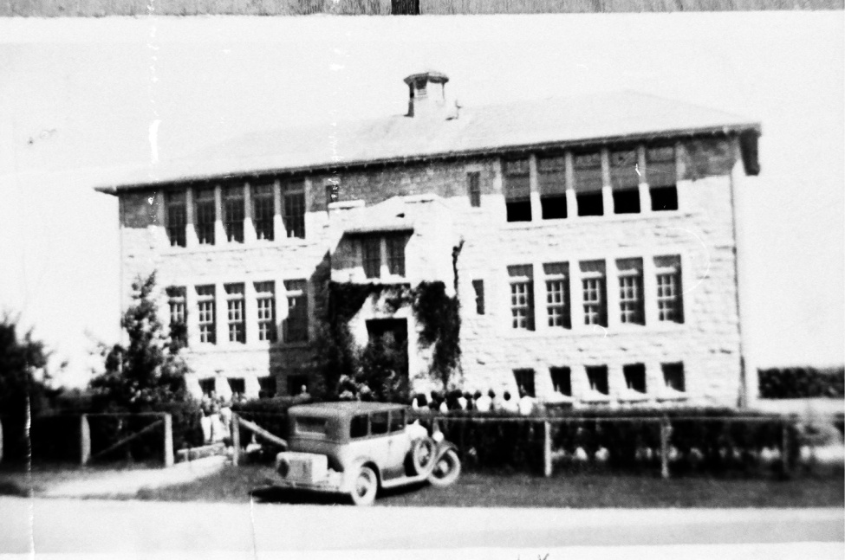
Churches and Schools
Notes:
1913 English Church in Selkirk; the old Happy Thought School

Slide 2
Colonial Times, 1825-1870

Slide 3
The First Churches
Missionaries and the Hudson Bay Company
Anglicans
William Cockran, 1825
St. Andrews On-the-Red
St. Peters
Presbyterians
John Black, 1851
Episcopacy issue
“The Meeting House”
Notes:
St. Andrews On-the-Red, c. 1912

Slide 4
The First Schools
St. Andrews Rectory School
St. Peters settlement school
Presbyterian school
Notes:
Pictured: St. Andrews Rectory, 1880s

Slide 5
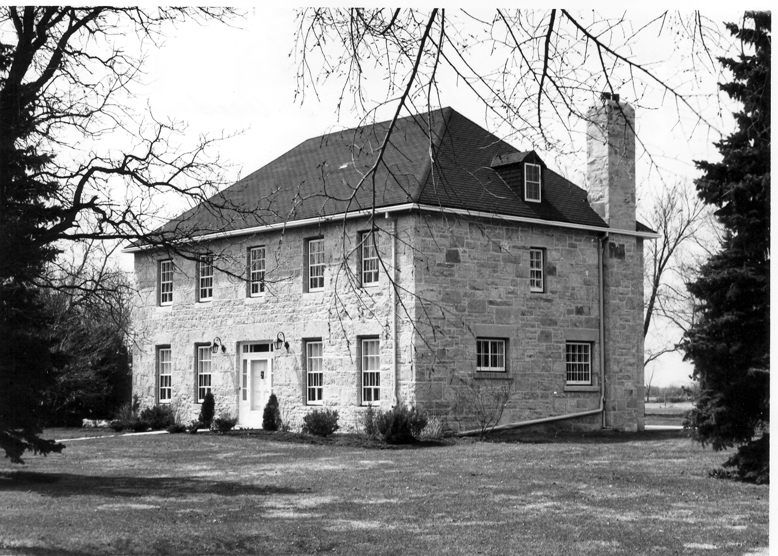
The First Schools (cont.)
Miss Matilda Davis’s Oakfield school for girls
Notes:
1970 image of the school building from 1858

Slide 6
Churches and Schools in a New Province

Slide 7
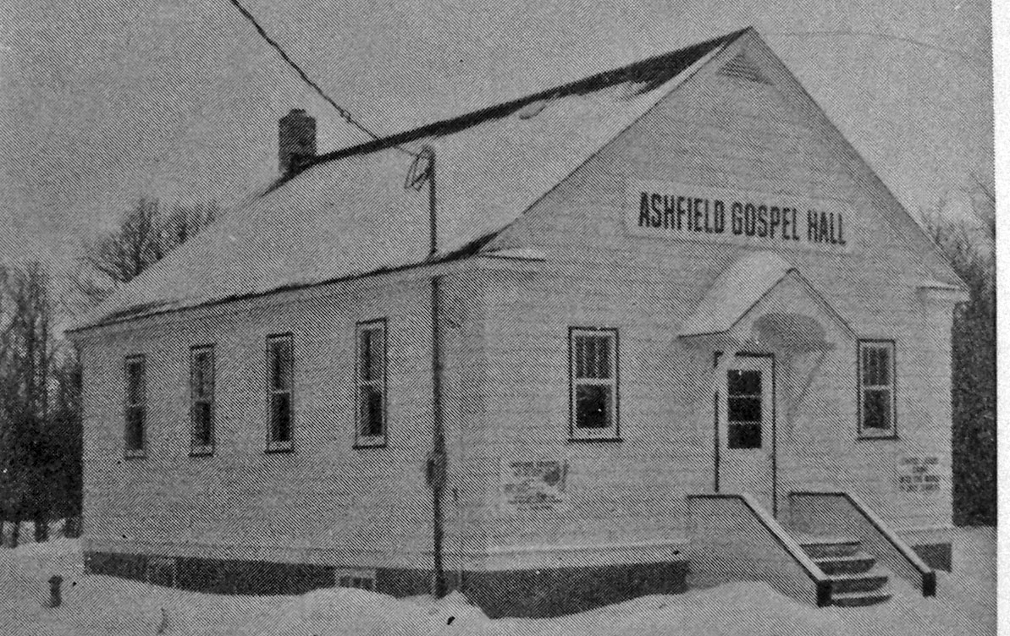
New Churches
Population growth ended Anglican-Presbyterian era
Lutherans, Methodists, Pentecostals, Plymouth Brethren
Notre Dame Parish (1874)
Notes:
Trinity Lutheran Church, Thalberg; Ashfield Gospel Hall

Slide 8
New Immigration
Eastern Europeans
The Public School Act
Compulsory school attendance in 1916

Slide 9
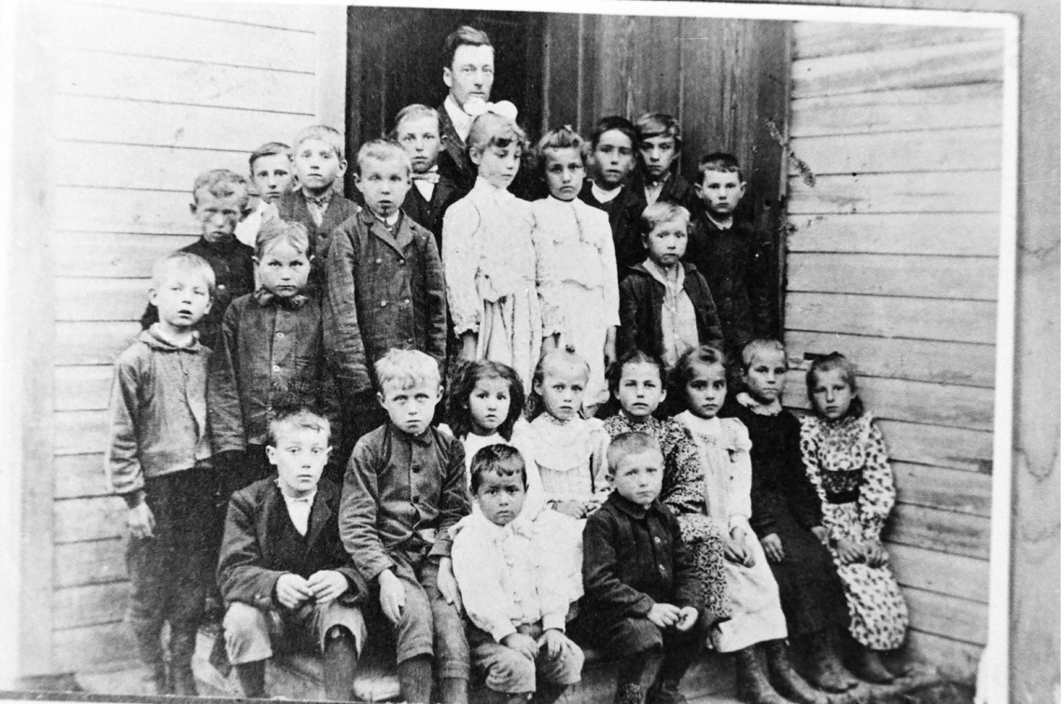
Notes:
Era of one room schoolhouses. Top left: Mars School west of Libau in 1914. Top right: Hoey West School and pupils with teacher Mr. McNeil, 1946. Bottom left: class of Donald School. Bottom right: Central School, Selkirk, 1897.

Slide 10
Modernist Theologians
Modernism = the Bible has myths and errors
Darwinism = evolutionism
The Social Gospel = save society instead of souls
Notes:
Movements promoted by influential theologians that changed churches’ mentalities

Slide 11
The United Church, 1925
United Canada’s Methodists, Presbyterians, and Congregationalists
One third of Presbyterian churches stayed out
Notes:
Left: Little Britain United Church in 1970 (built in 1860s). Right: Knox Presbyterian with a ferry out front. Little Britain joined the UC, Knox stayed out.

Slide 12
Socialism
Social Gospel Progressivism
The Great Depression

Slide 13
Society from Church to School

Slide 14
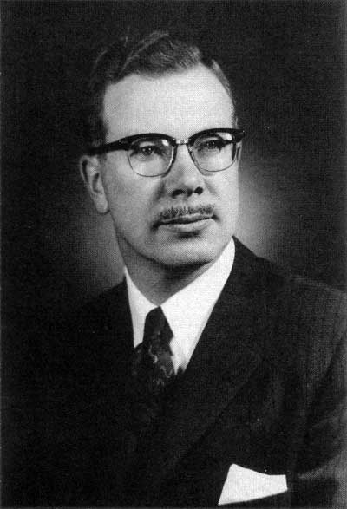
Premier Duff Roblin (1958-1967)
“Red Tory”
Views on education
Baby Boomers and the need for more schools

Slide 15
Roblin’s School Reforms
Public high schools
Consolidated schools into districts centred on new public high schools
Introduced school bus program
The school as the centre of society; decline of church influence

Slide 16
Post-War Churches
Ecumenism and non-denominational churches
Population growth
Grace Baptist Church, Selkirk
Selkirk Mennonite Brethren
Summary: The centre of society shifted from churches to schools.

