Slide 1
The Red River and Lake Winnipeg
Their influence in regional history
Notes:
Pictured: Steamer Makado in 1913

Slide 5
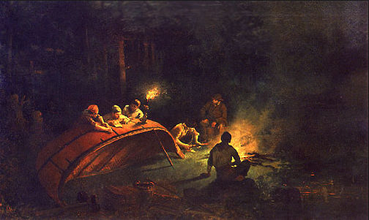
The Fur Trade

Slide 6
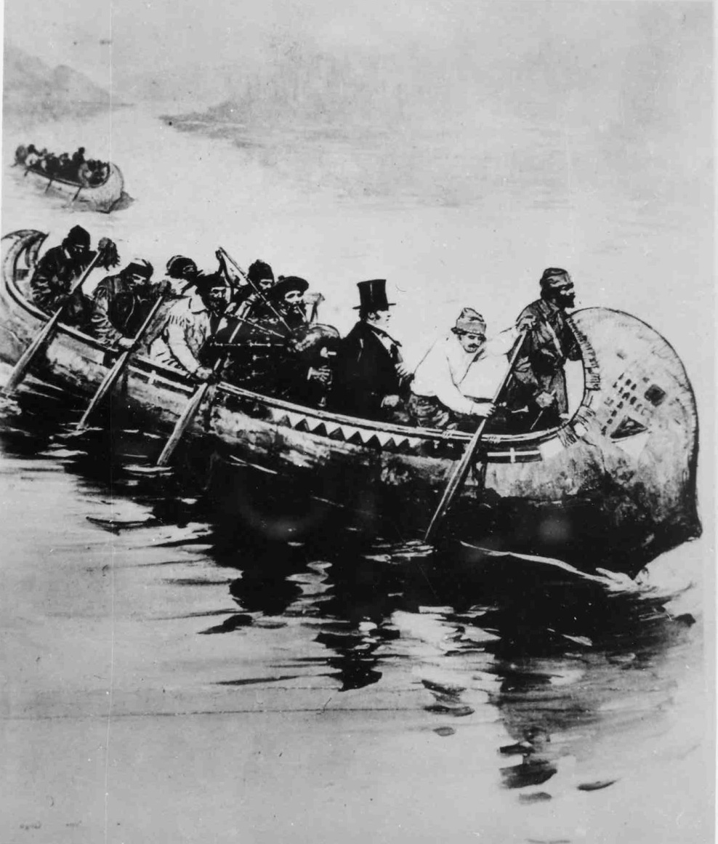
Canoes
Notes:
1850s canoe carrying dignitary (likely George Simpson with his piper)

Slide 7
York Boats
Viking design
“Brigades”
The “York Main Line”
435 mile voyage from York Factory to Norway House

Slide 8
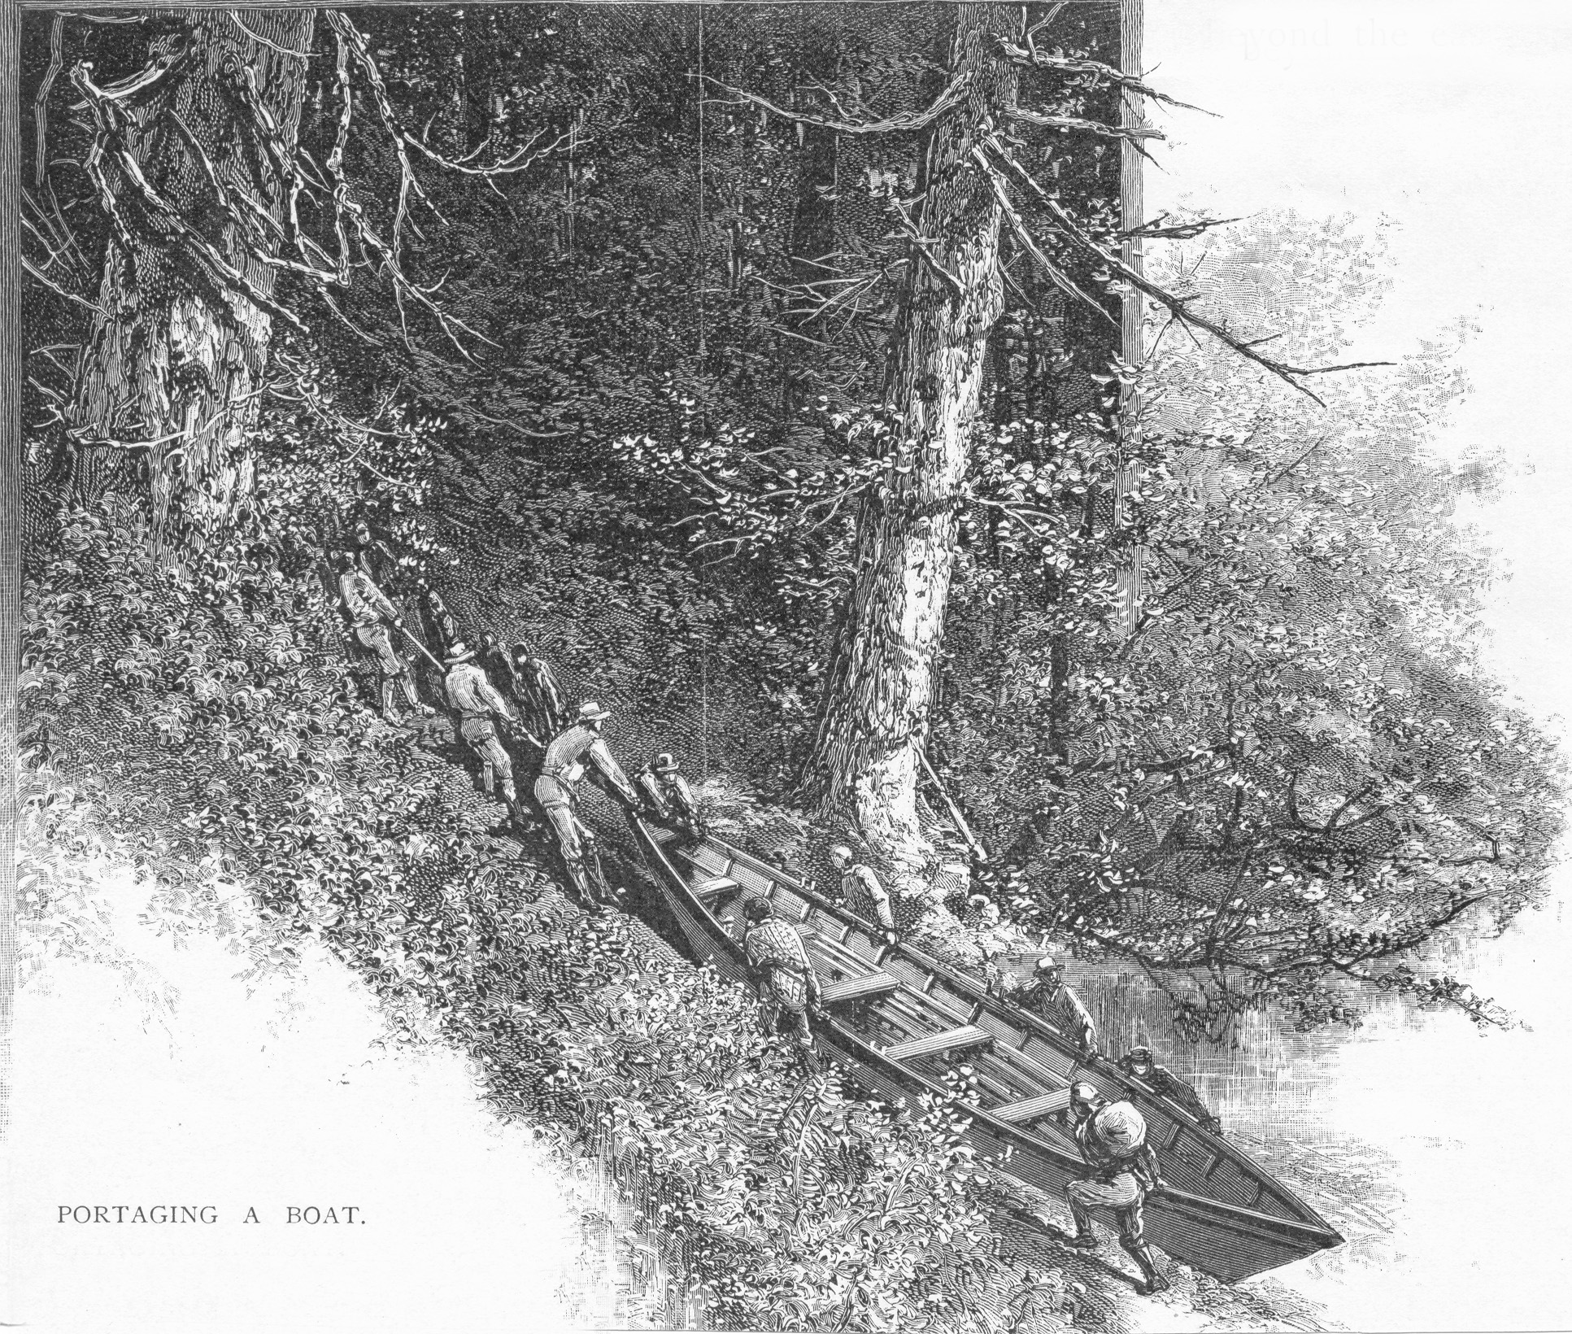
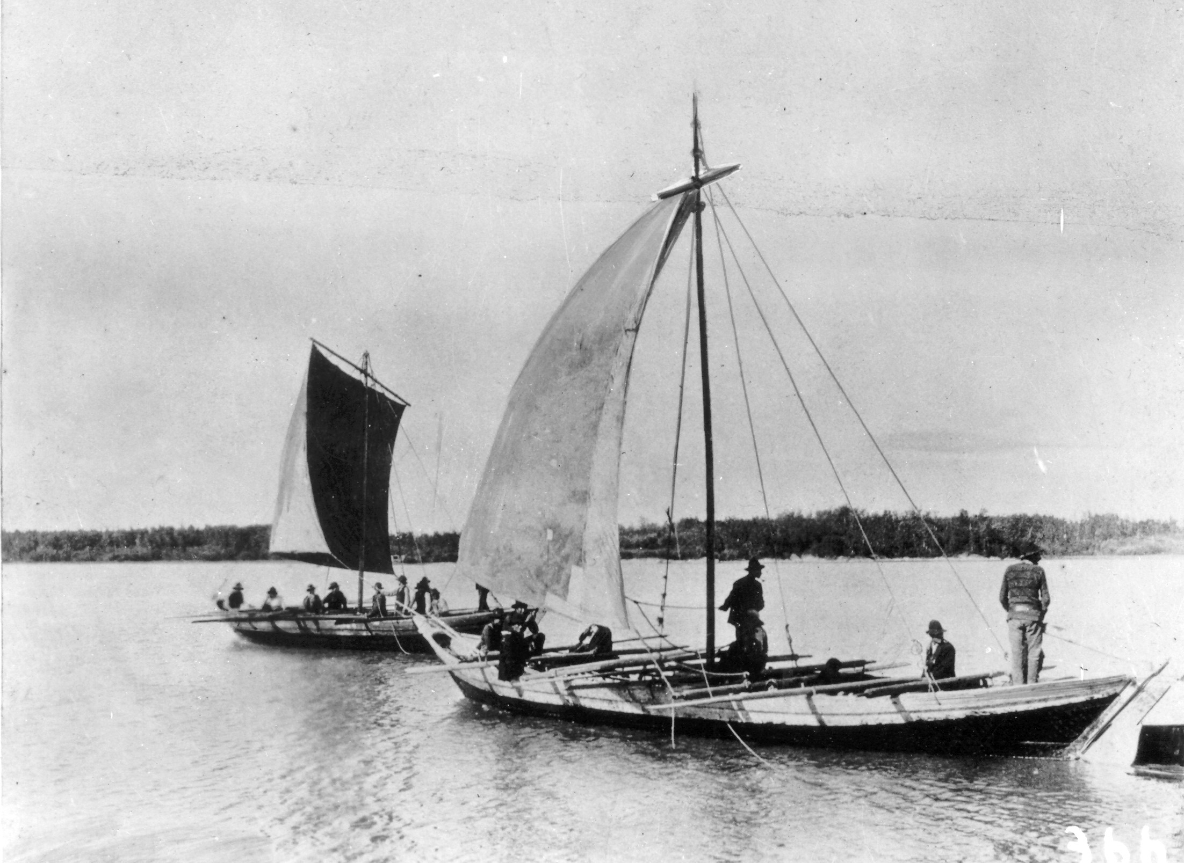

Slide 9
Significance of York boats
Extended Hudson Bay Company domains
Paved the way for the Selkirk Colony
Facilitated missionary work
Helped preserve British sovereignty

Slide 10
Red River
Notes:
1859 John Harriott residence

Slide 11
Missionaries
James Evans
Methodist Rossville mission at Norway House
Invented the Cree alphabet
William Cockran
Anglican Church Missionary Society (CMS)
Lower Church (St. Andrews)
St. Peters

Slide 12
The Selkirk Settlers
Came via York boat
Settled along the river

Slide 13
Notes:
1816 – Selkirk Settlers at York Factory

Slide 14
The Forks the Seat of Government
George Simpson
Lower Fort Garry (1830)
Council of Assiniboia (1821-70)

Slide 15
Local Political Figures
Thomas Bunn
St. Clements
Louis Riel’s “Secretary of State”
Donald Gunn
St. Andrews
Presbyterian leader, historian, naturalist
Notes:
Gunn corresponded with the Smithsonian Museum on scientific observations in the northwest

Slide 16
Local Political Figures
Alfred Boyd
St. Andrews
Opposed Louis Riel
Manitoba’s ‘first premier’
Thomas Spence
St. Peters
“Republic of Manitobah”

Slide 17
The Port of Selkirk

Slide 18
Selkirk’s Strategic Location
Below the St. Andrews Rapids
Safe from flooding on high ground
Had a railway branch line
East and west sloughs for wintering

Slide 19
Famous Steamboats
S.S. Anson Northrup
First steamboat in Manitoba
S.S. Chief Commissioner
First steamboat to operate on Lake Winnipeg

Slide 20
Famous Steamboats (cont.)
S.S. Colvile (1875-1894)
Treaty Five (1875)
Lord Dufferin’s visit (1877)
North-West Rebelion (1885)

Slide 21
William Robinson
Northwest Navigation Company
Dominion Fish Company
William Robinson Company
Notes:
Robinson’s warehouse with rail connection at Selkirk docks

Slide 22
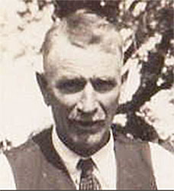
William Purvis
Northern Fish Company
Shipbuilding
Notes:
Northern Fish Co. Tug on lake, 1922.

Slide 23
Theodore Arthur Burrows
Selkirk Lumber Company (1883)
Notes:
Wooding station at Bull Head, Lake Winnipeg, 1922

