Slide 1
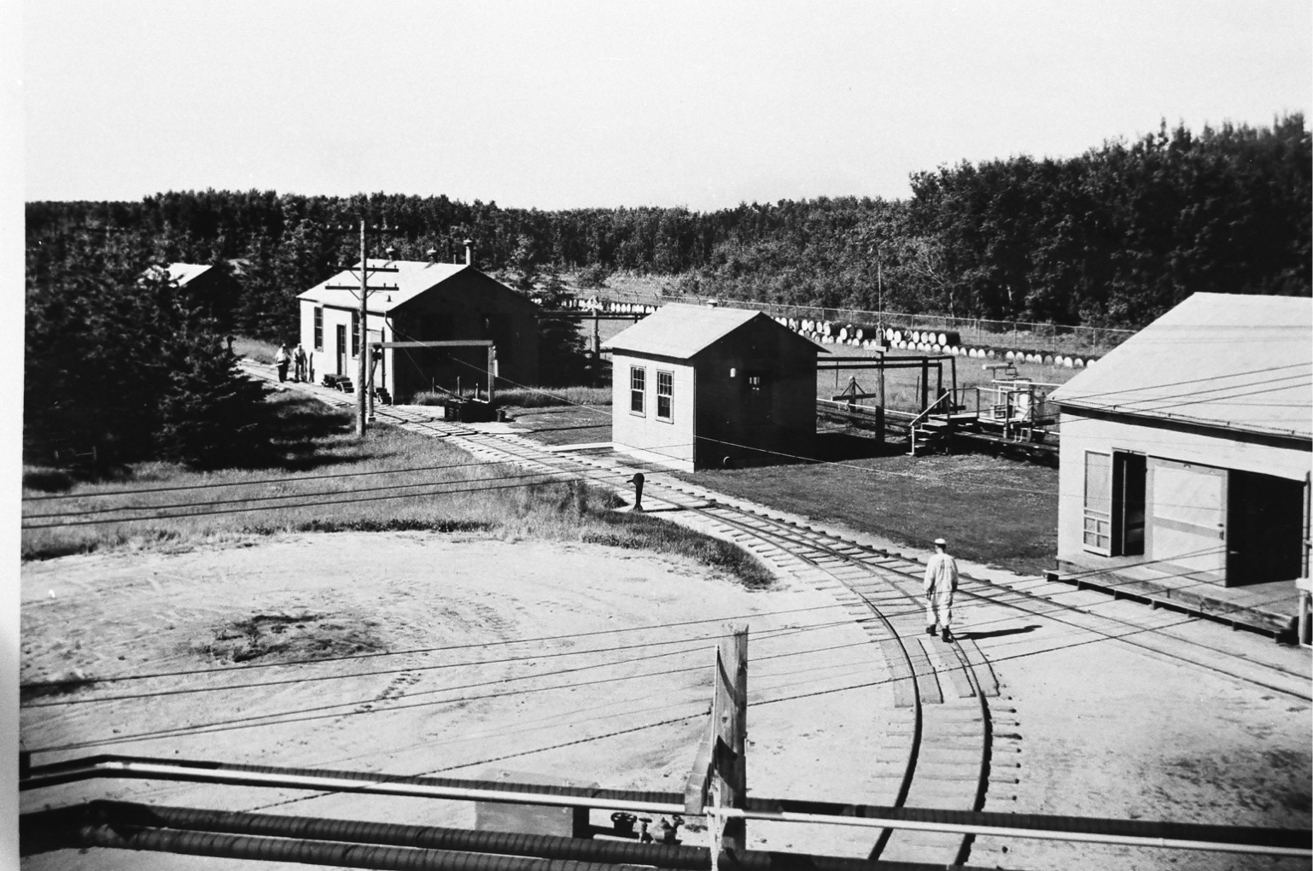
Early Industries
Notes:
CIL Dynamite Plant

Slide 2
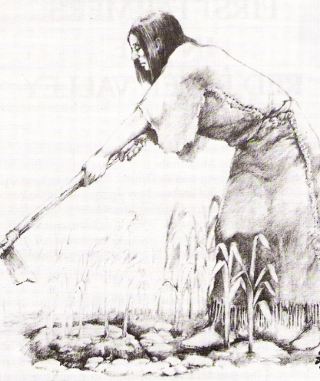
Pre-Contact
Horticulture at Lockport
Fur trade forts
Fort Maurepas (1730s)
Lower Fort Garry (1830s)

Slide 3
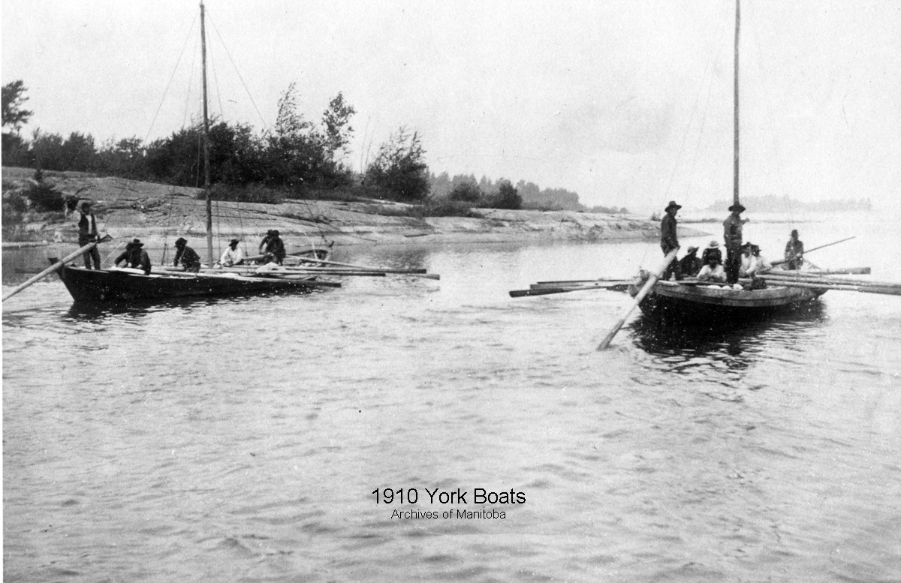
York Boats
“Brigades”
La Loche Brigade
Notes:
Top right c. 1900. on Cross Lake. Bottom left: 1890

Slide 4
The Red River Colony
St. Peters Windmill
Notes:
No known images exist of St. Peters windmill. This is Paul Kane’s painting “Young’s Mill” outside Lower Fort Garry.

Slide 5
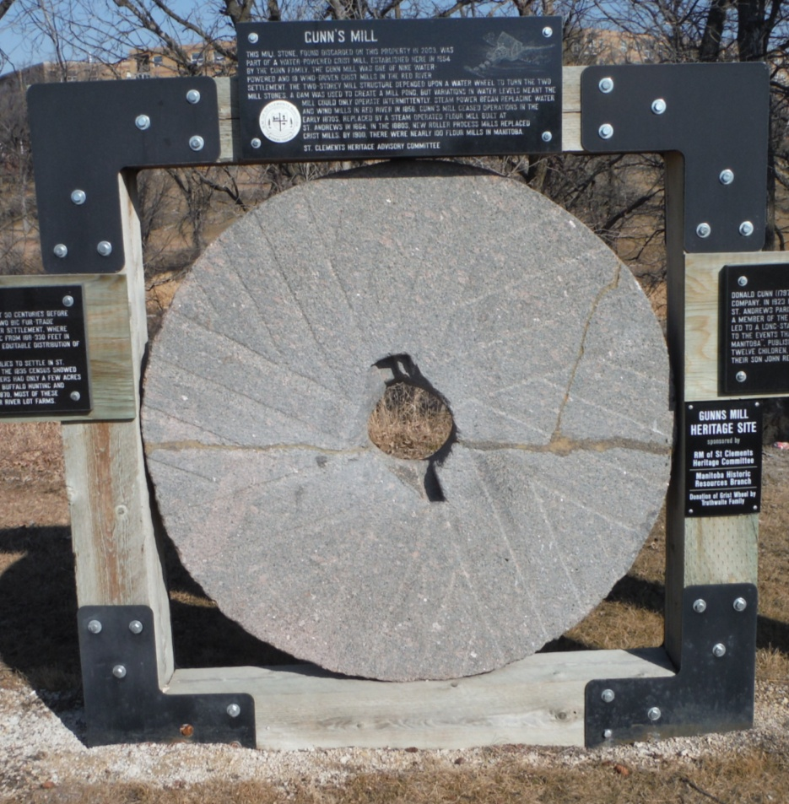
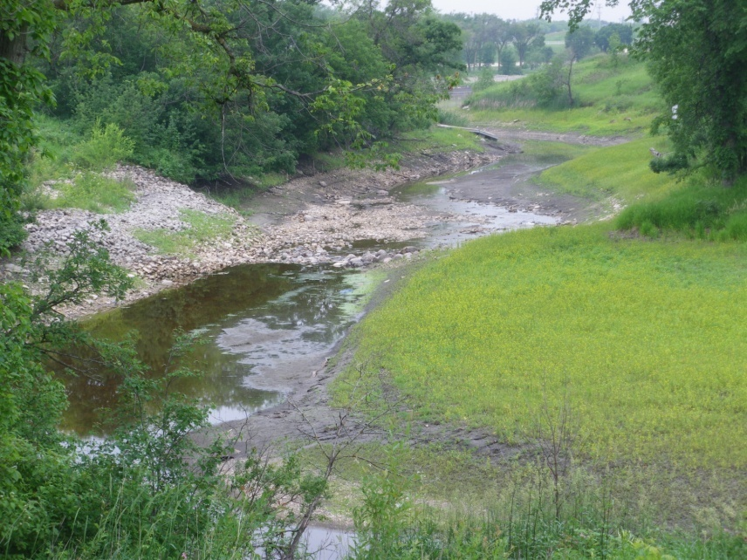
The Red River Colony
Gunn’s Creek Flour Mill

Slide 6
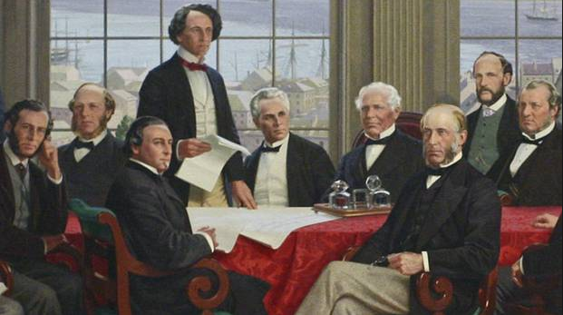
Confederation

Slide 7
The Merchants of Selkirk
W.H. Eaton – general store
Related to Methodist retail mogul Timothy Eaton
Eaton Avenue
R. H. Gilhuly – drug store
James Cocleugh – first mayor

Slide 8
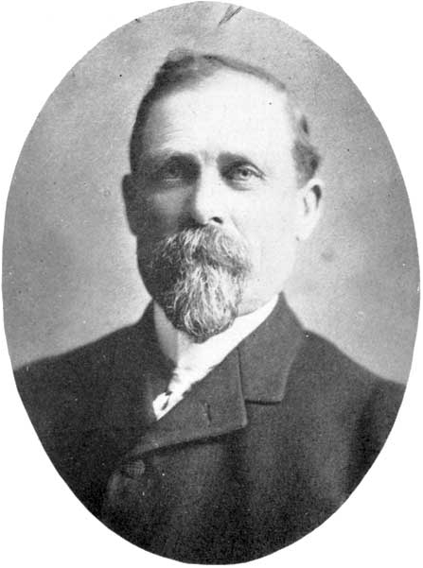
Lords of the Lake
William Robinson
Colvile voyage
Buying up lake businesses
Monopoly on the lake
Robinson Avenue
William Purvis and Joe Simpson
Northern Fish Company
Shipbuilding

Slide 9
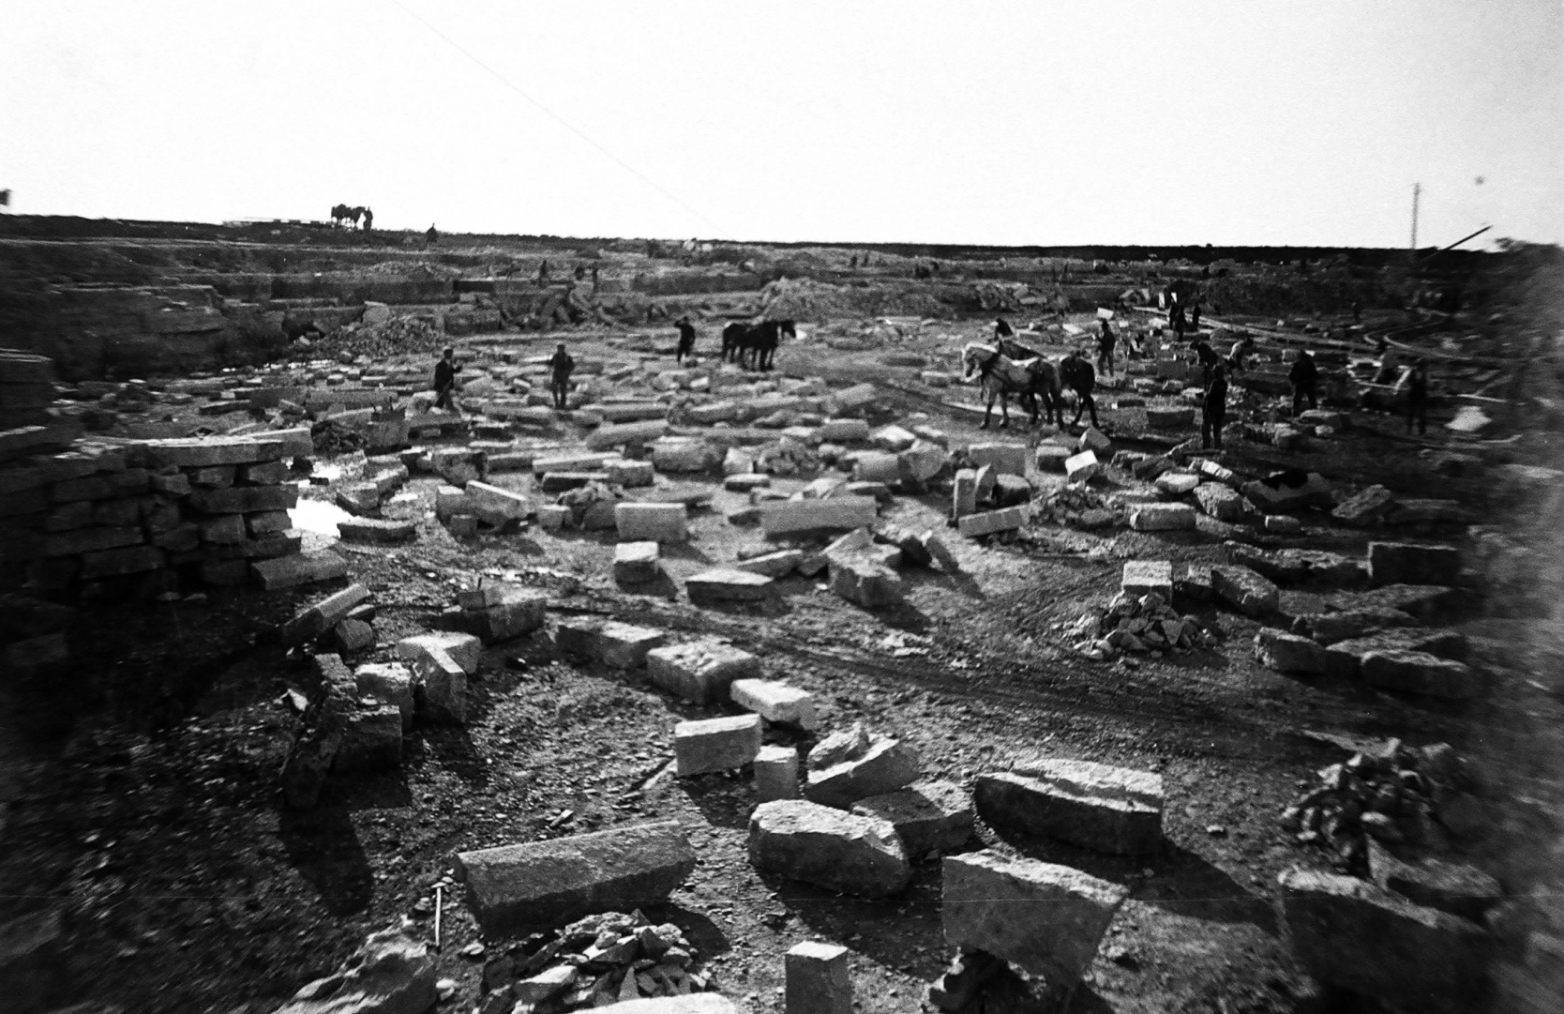
Other Industries
Quarries in East Selkirk

Slide 10
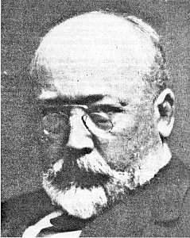
Other Industries (cont.)
Van Horne Farm (1899)

Slide 11
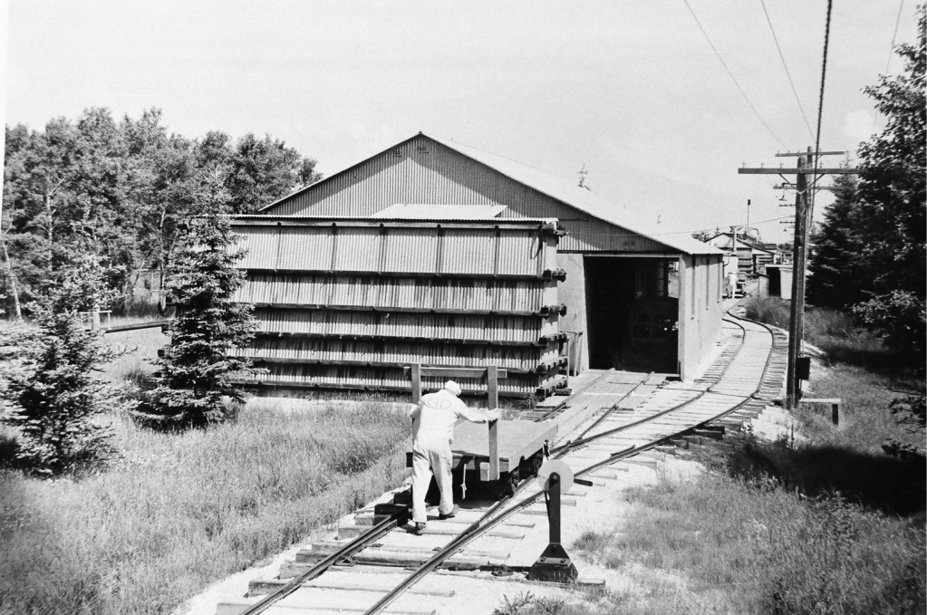
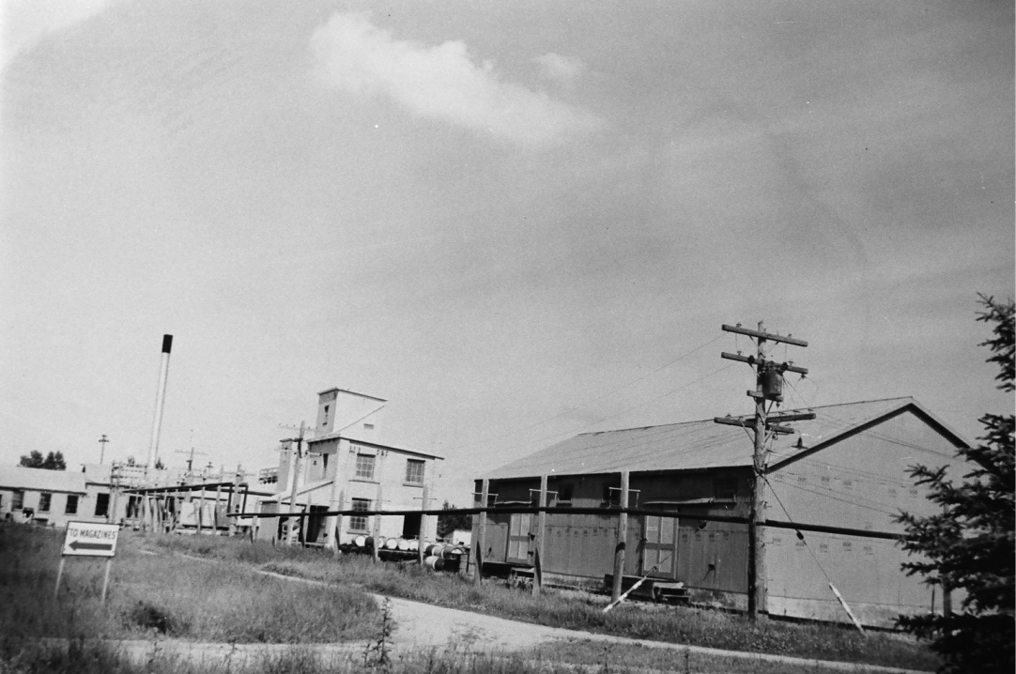
Other Industries (cont.)
Selkirk steel mill (1913)
CIL Dynamite Plant (1934)
Notes:
Pictured: CIL Dynamite Plant

Slide 12
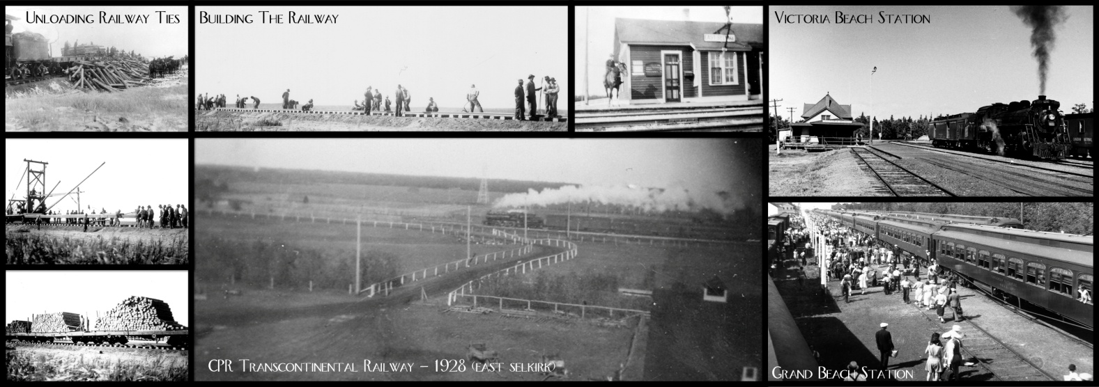
Progress in Transportation

Slide 13
Steamboats, 1859-1877
S.S. Anson Northrup (1859)
Steamboats made York boats obsolete
Railways made steamboats obsolete

Slide 14
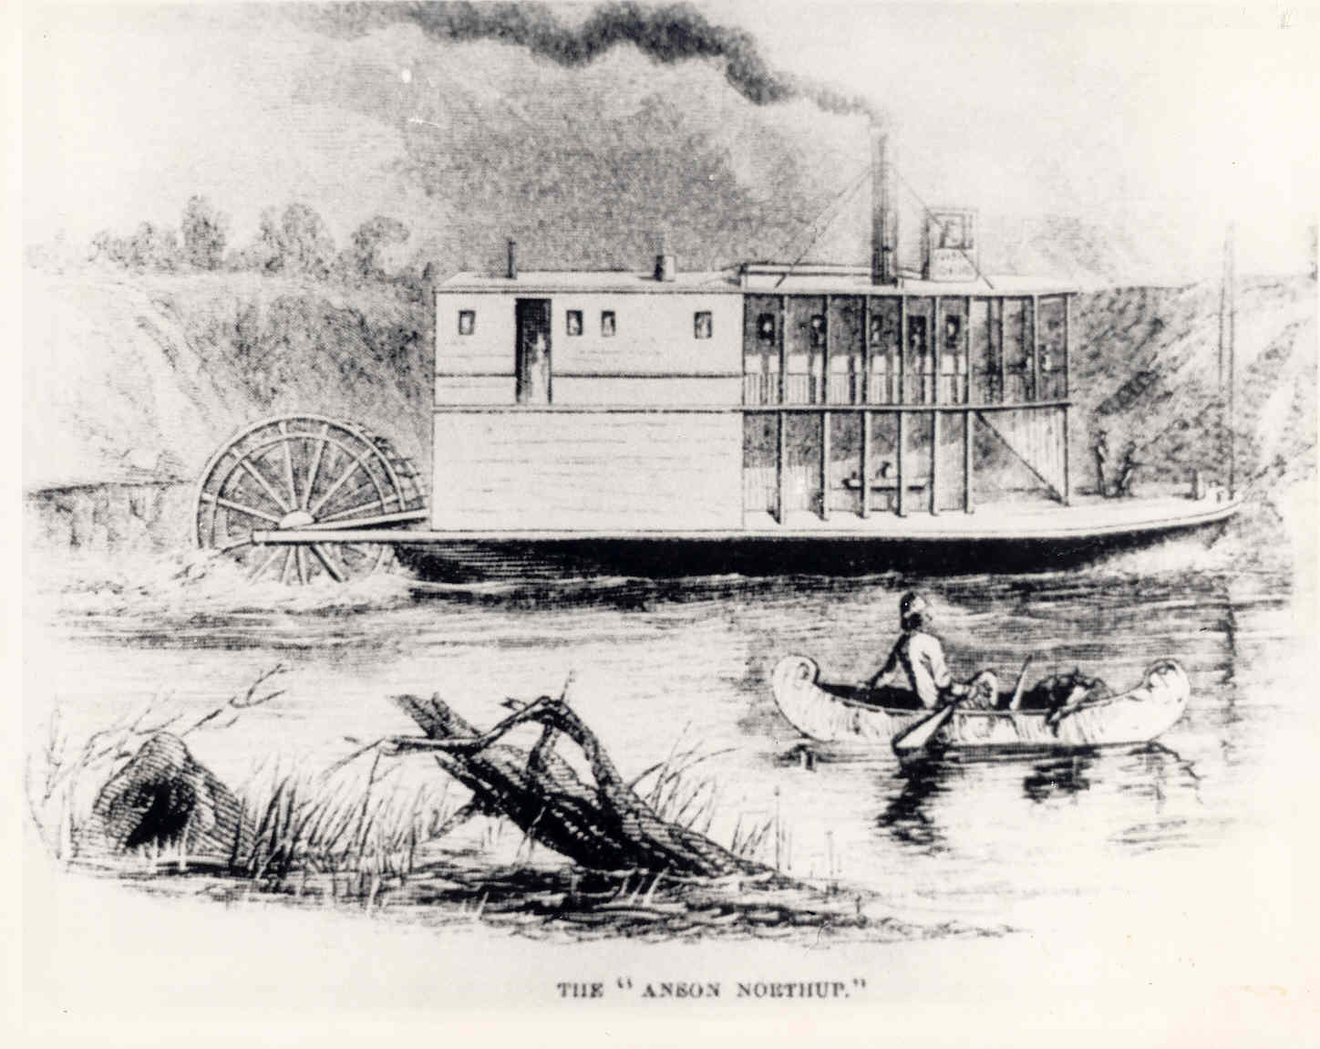

Slide 15
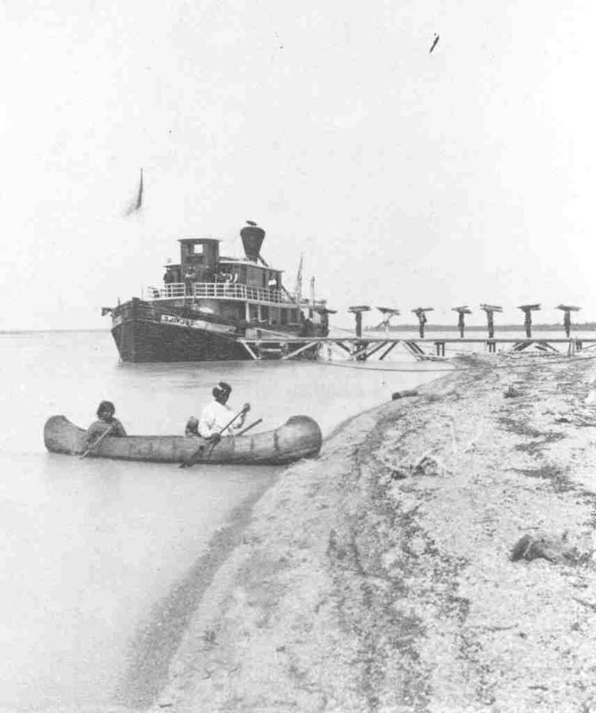
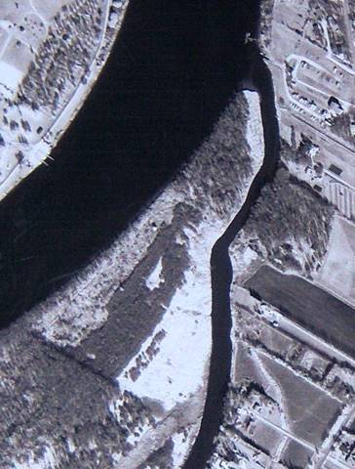
The Port of Selkirk
Home port for steamboats below the St. Andrews Rapids
Colvile Landing (1880)
Notes:
Left: S.S. Colvile at Norway House, c. 1880. Right: The east slough, site of Colvile Landing.
Called “Sault a la Biche”
Rapids run for 10 miles, north from Middlechurch with a 15 ft fall.
Very large boulders are a major obstacle for major shipping
Steamers over 120ft long could not navigate the rapids and only shallow draft stern-wheeled steamers
Some large boulders were removed in 1870 – but no major improvement
Creation of a dam would raise water levels to allow shipping to Winnipeg and access to Saskatchewan river system to the foot of the Rockies

Slide 16
Expansion of Railways
Selkirk branch line in 1883
Clandeboye in 1902
Selkirk-Winnipeg electric street car in 1908

Slide 17
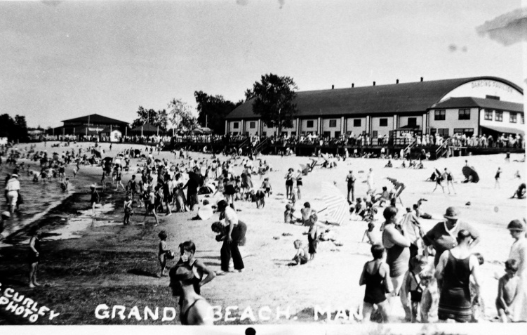
Resorts
Winnipeg Beach – CPR, 1902
Grand Beach – CNR, 1914
Victoria Beach – CNR, 1916

Slide 18
Roads
Early Roads
River Road
The King’s Road
Corduroy Roads
The 1920s
John Bracken’s paving program
Red River Motor Coach Bus Lines (1925)

Slide 19
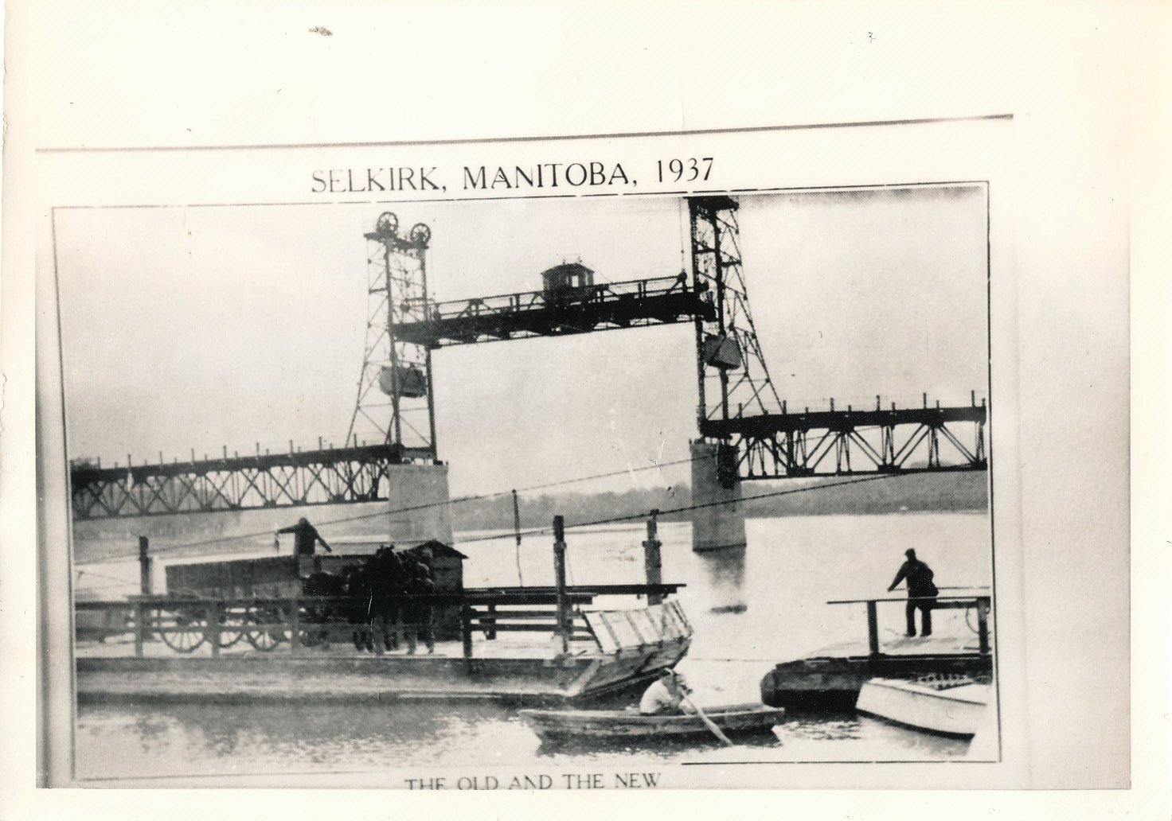
Selkirk Bridge
Notes:
Caption reads “The Old and the New”

