Slide 1
The Red River and Lake Winnipeg
Their influence in regional history
Notes:
Pictured: Steamer Makado in 1913

Slide 2
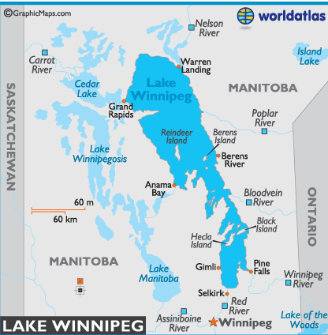

Slide 3
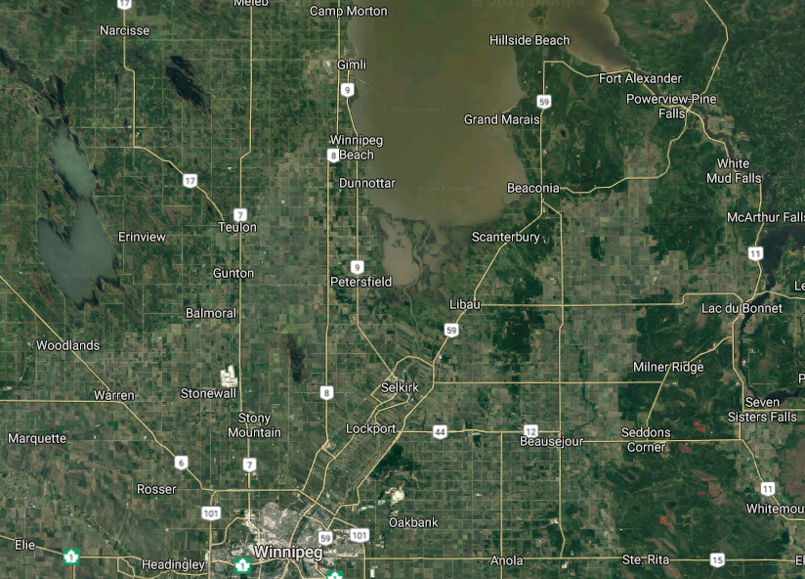

Slide 4
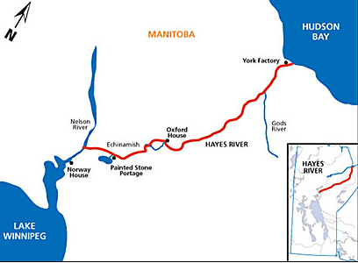

Slide 5
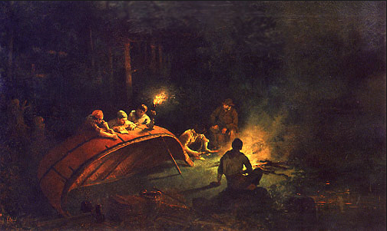
The Fur Trade

Slide 6
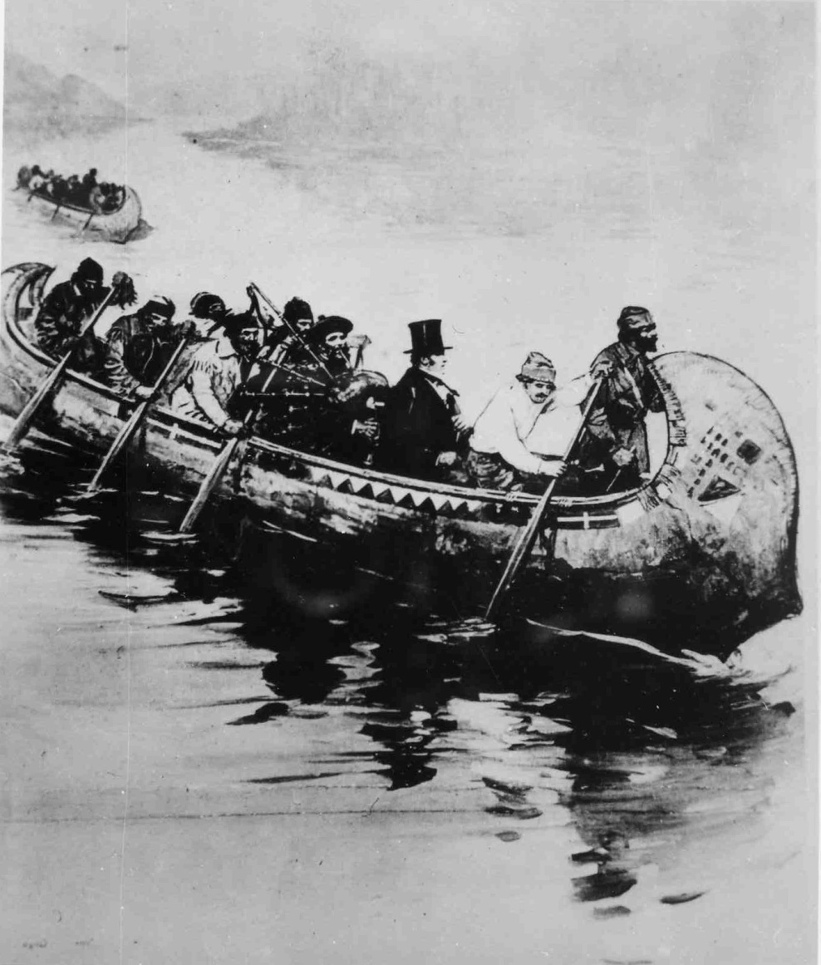
Canoes
Notes:
1850s canoe carrying dignitary (likely George Simpson with his piper)

Slide 7
York Boats
Viking design
“Brigades”
The “York Main Line”
  435 mile voyage from York Factory
  to Norway House

Slide 8
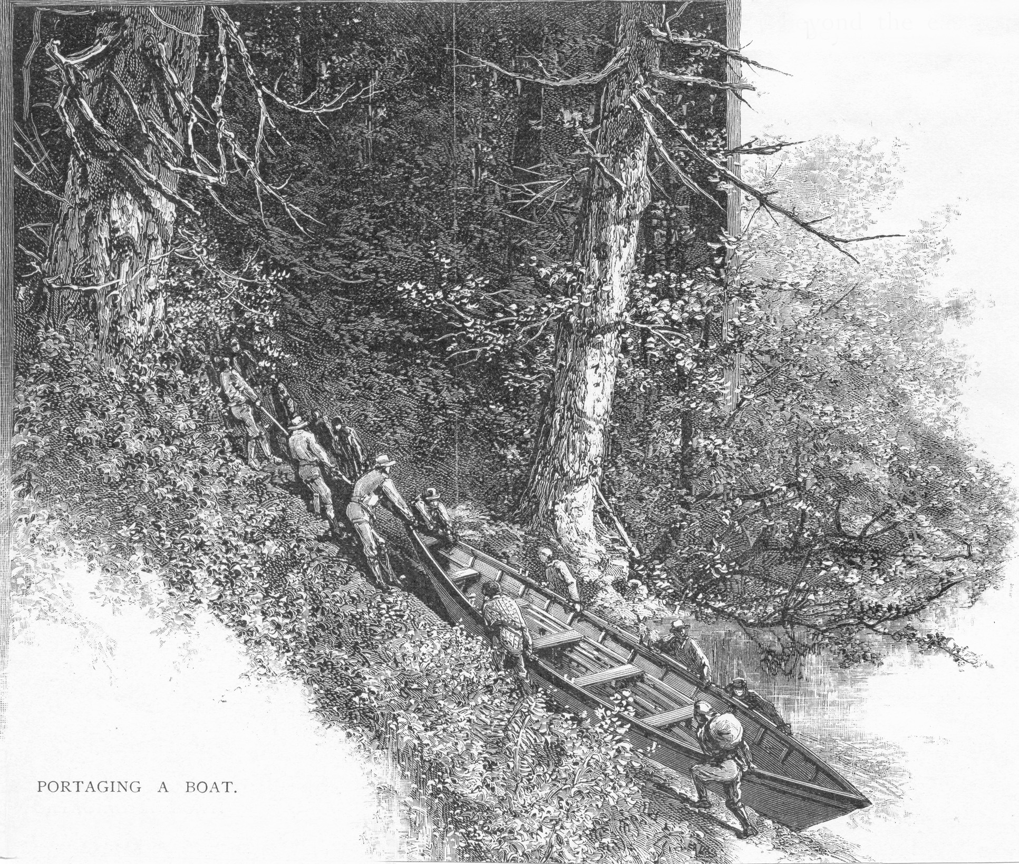
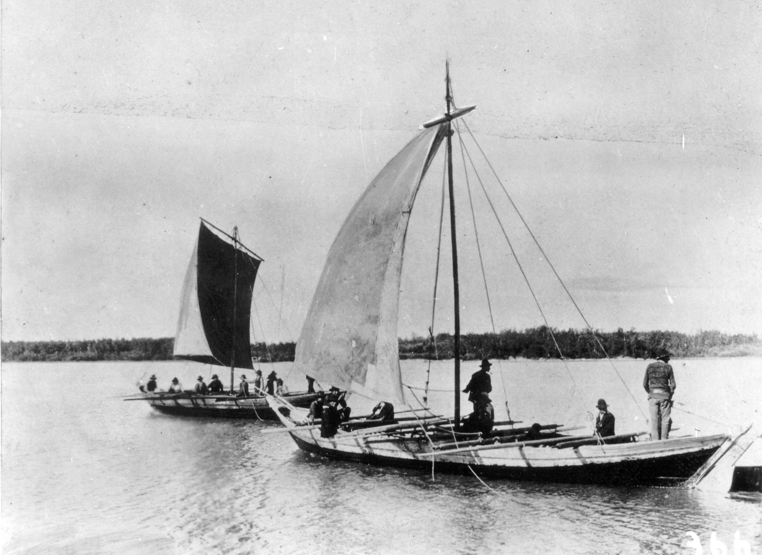

Slide 9
Significance of York boats
Extended Hudson Bay Company domains
Paved the way for the Selkirk Colony
Facilitated missionary work
Helped preserve British sovereignty

Slide 10
Red River
Notes:
1859 John Harriott residence

Slide 11
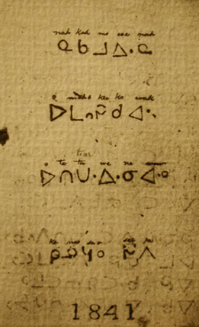
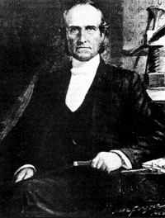
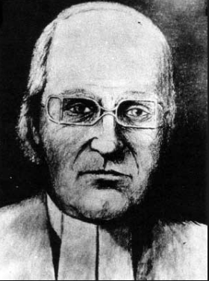
Missionaries
James Evans
  Methodist Rossville mission
  at Norway House
  Invented the Cree alphabet
William Cockran
  Anglican Church Missionary Society (CMS)
  Lower Church (St. Andrews)
  St. Peters

Slide 12
The Selkirk Settlers
Came via York boat
Settled along the river

Slide 13
Notes:
1816 – Selkirk Settlers at York Factory

Slide 14
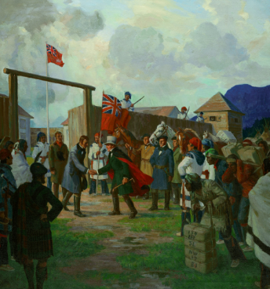
The Forks the Seat of Government
George Simpson
Lower Fort Garry (1830)
Council of Assiniboia (1821-70)

Slide 15
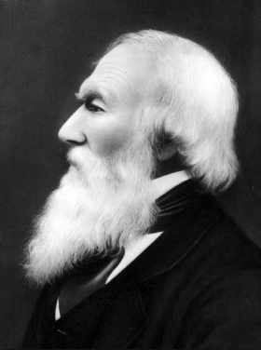
Local Political Figures
Thomas Bunn
  St. Clements
  Louis Riel’s “Secretary of State”
Donald Gunn
  St. Andrews
  Presbyterian leader, historian,
  naturalist
Notes:
Gunn corresponded with the Smithsonian Museum on scientific observations in the northwest

Slide 16
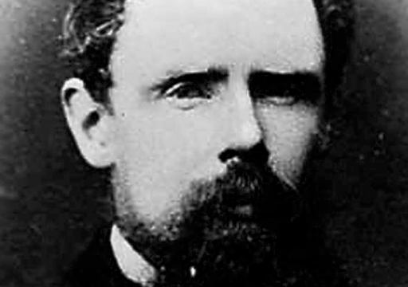
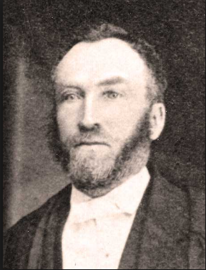
Local Political Figures
Alfred Boyd
  St. Andrews
  Opposed Louis Riel
  Manitoba’s ‘first premier’
Thomas Spence
  St. Peters
  “Republic of Manitobah”

Slide 17
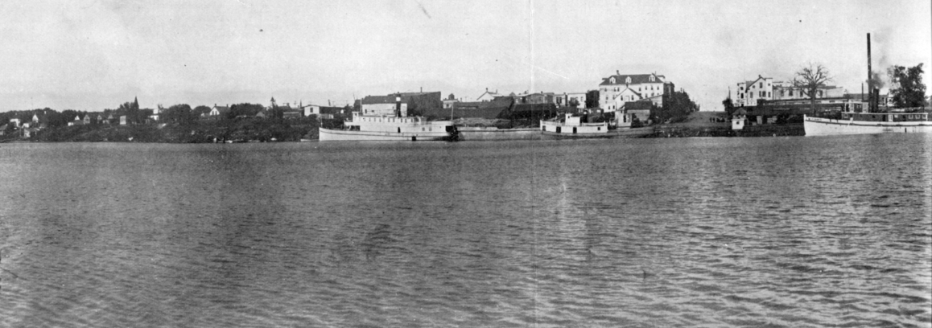
The Port of Selkirk

Slide 18
Selkirk’s Strategic Location
Below the St. Andrews Rapids
Safe from flooding on high ground
Had a railway branch line
East and west sloughs for wintering

Slide 19
Famous Steamboats
S.S. Anson Northrup
  First steamboat in Manitoba
S.S. Chief Commissioner
  First steamboat to operate on Lake Winnipeg

Slide 20
Famous Steamboats (cont.)
S.S. Colvile (1875-1894)
  Treaty Five (1875)
  Lord Dufferin’s visit (1877)
  North-West Rebelion (1885)

Slide 21
William Robinson
Northwest Navigation Company
Dominion Fish
Company
William
Robinson
Company
Notes:
Robinson’s warehouse with rail connection at Selkirk docks

Slide 22
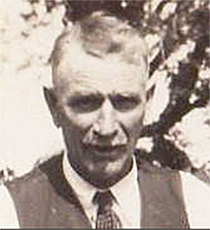
William Purvis
Northern Fish Company
Shipbuilding
Notes:
Northern Fish Co. Tug on lake, 1922.

Slide 23
Theodore Arthur Burrows
Selkirk Lumber Company (1883)
Notes:
Wooding station at Bull Head, Lake Winnipeg, 1922

