Slide 1
Eastern European Immigration

Slide 2
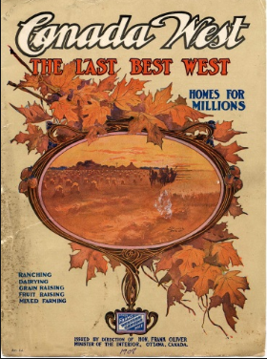


Slide 3
Canada’s Immigration Initiative

Slide 4
Macdonald Era
Dominion Lands Act (1872)
  160 acres per person for $10
  Must promise to cultivate 40 acres
  Must build a permanent residence in 3 years
End of the American frontier (1890)

Slide 5
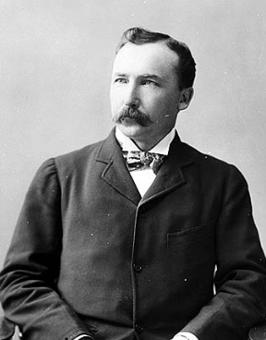
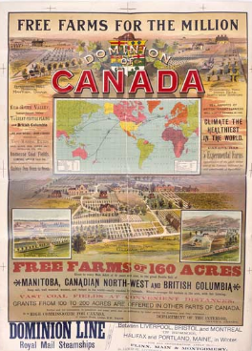
Laurier Era
Clifford Sifton
  Advertising campaigns
  “Peasants in sheep-skin coats”

Slide 6
“A Babel of Tongues”

Slide 7
Ukrainians
Austro-Hungarian Empire
  Galicia and Bukovina
Reasons for coming
  Land pressures
  Religious persecution by Poles
  “Russification”

Slide 8
Doukhobors and Poles
Doukhobors
  “Spirit wrestlers”
  Pacifists
  Anti-Tsarist
Poles
  Economic opportunity

Slide 9
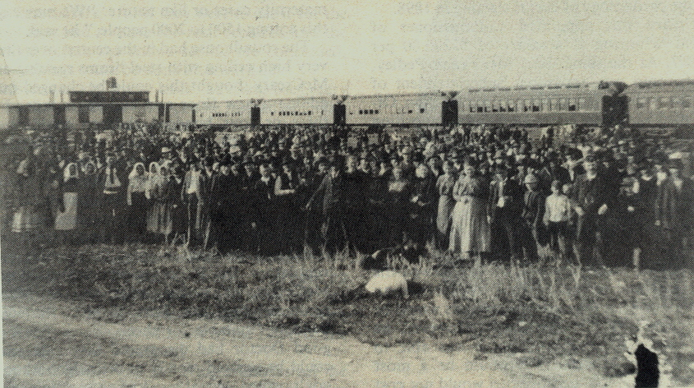
The East Selkirk Roundhouse

Slide 10
East Selkirk Immigration Shed
Built for the Canadian Pacific Railway
in 1876
Repurposed 1898-99
Dismantled 1906

Slide 11
New Settlements

Slide 12
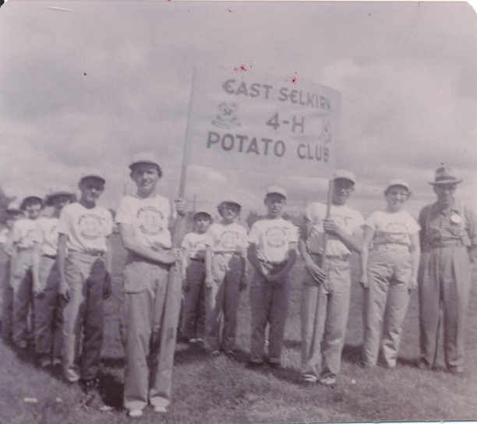
Ukrainians
East Selkirk

Slide 13
Ukrainians
Notes:
Right: remains of a Bukovina-style home in the Libau district

Slide 14
Ukrainians
Notes:
Close up of Bukovinian construction

Slide 15
Ukrainians
Narol and Gonor
Notes:
Harvesting at Gonor in 1905

Slide 16
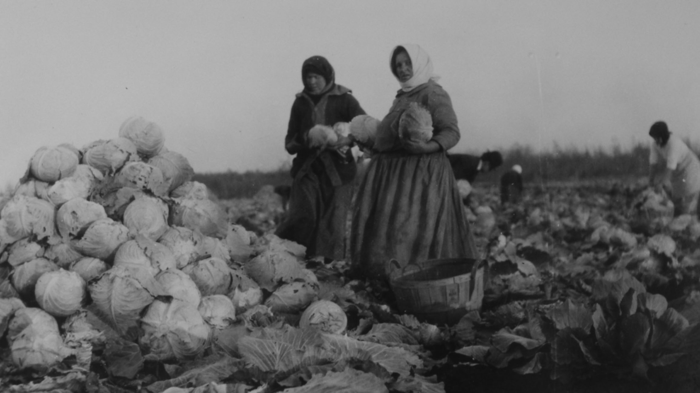
Notes:
Market gardening – picking cabbage

Slide 17
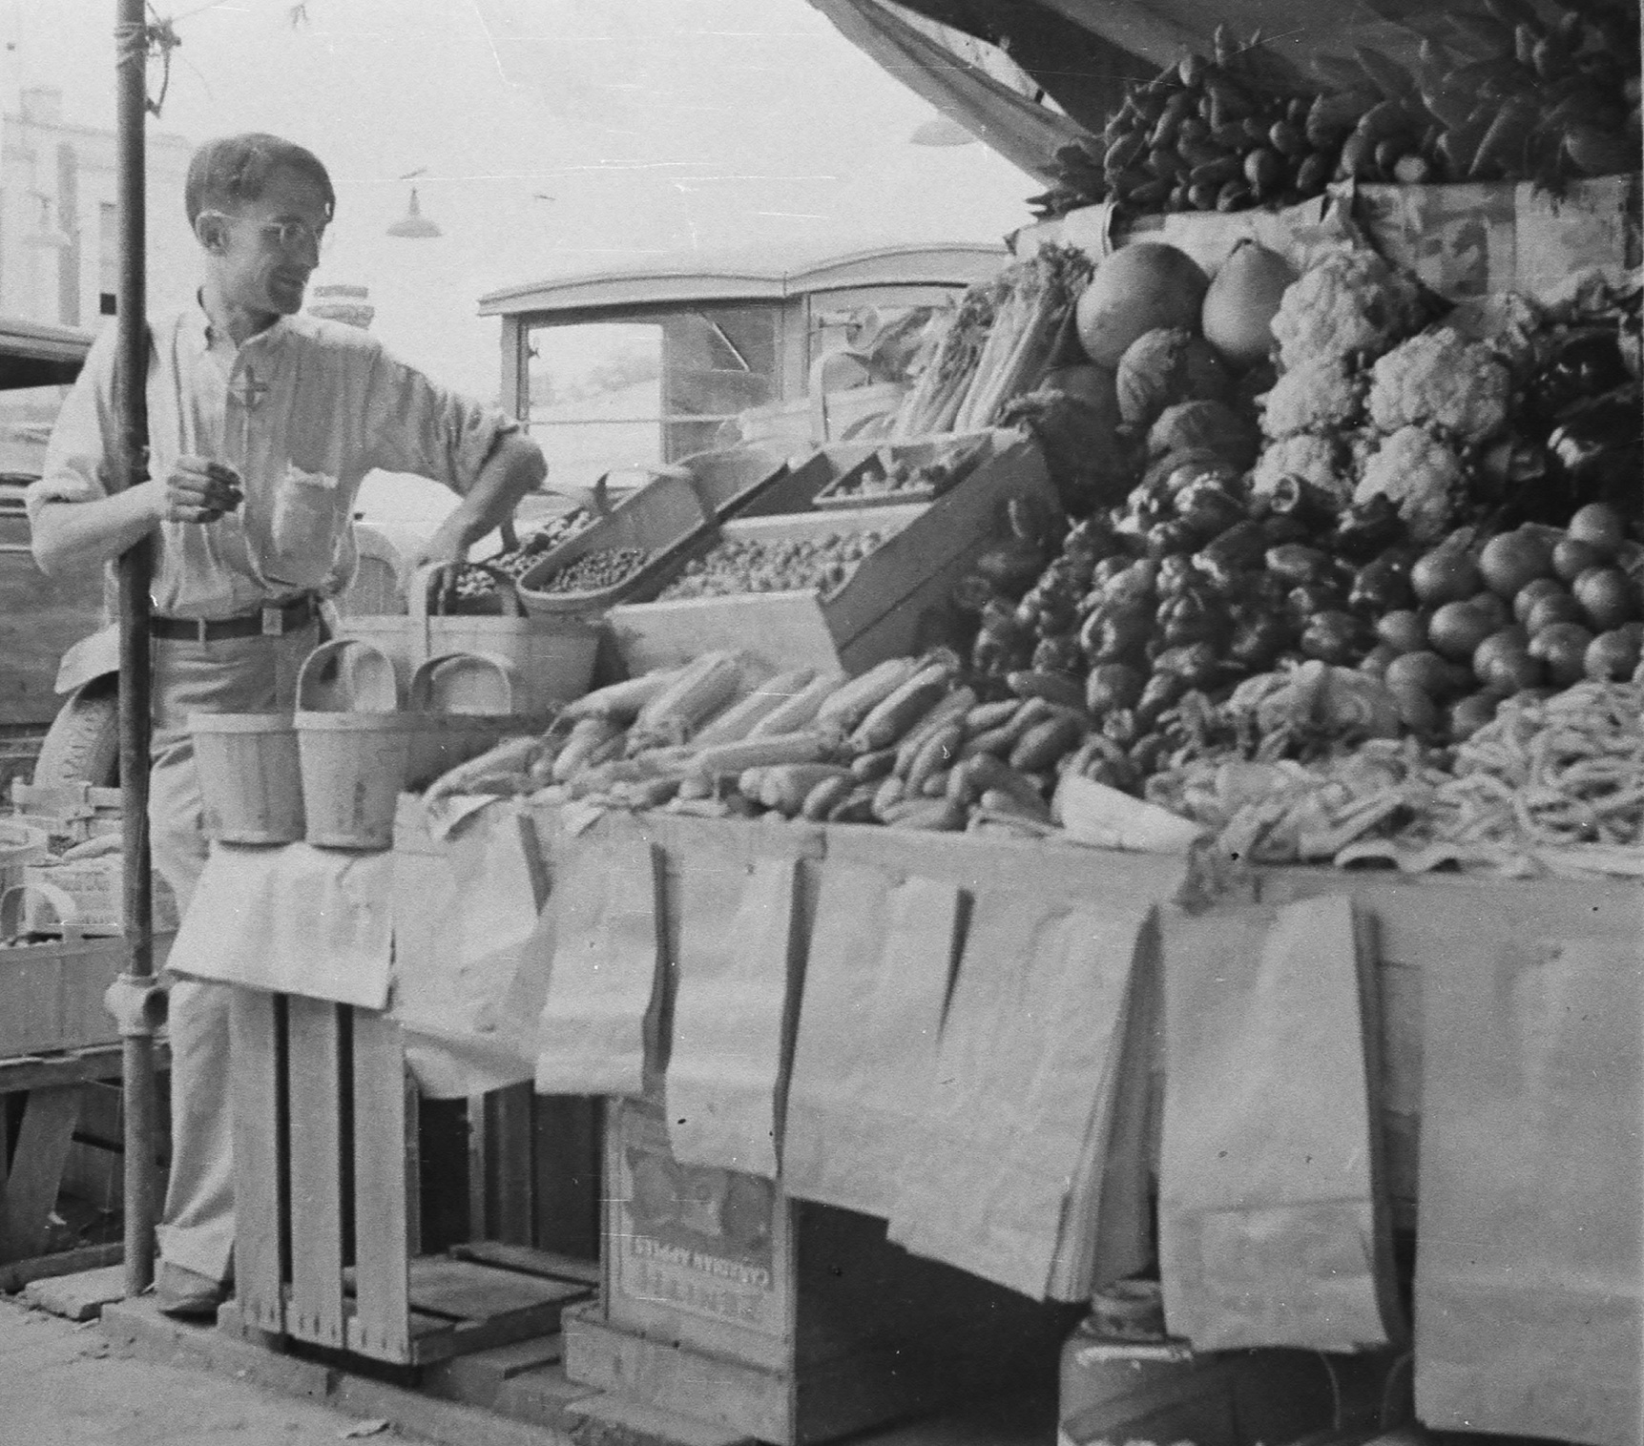
Notes:
North End market gardening, Winnipeg

Slide 18
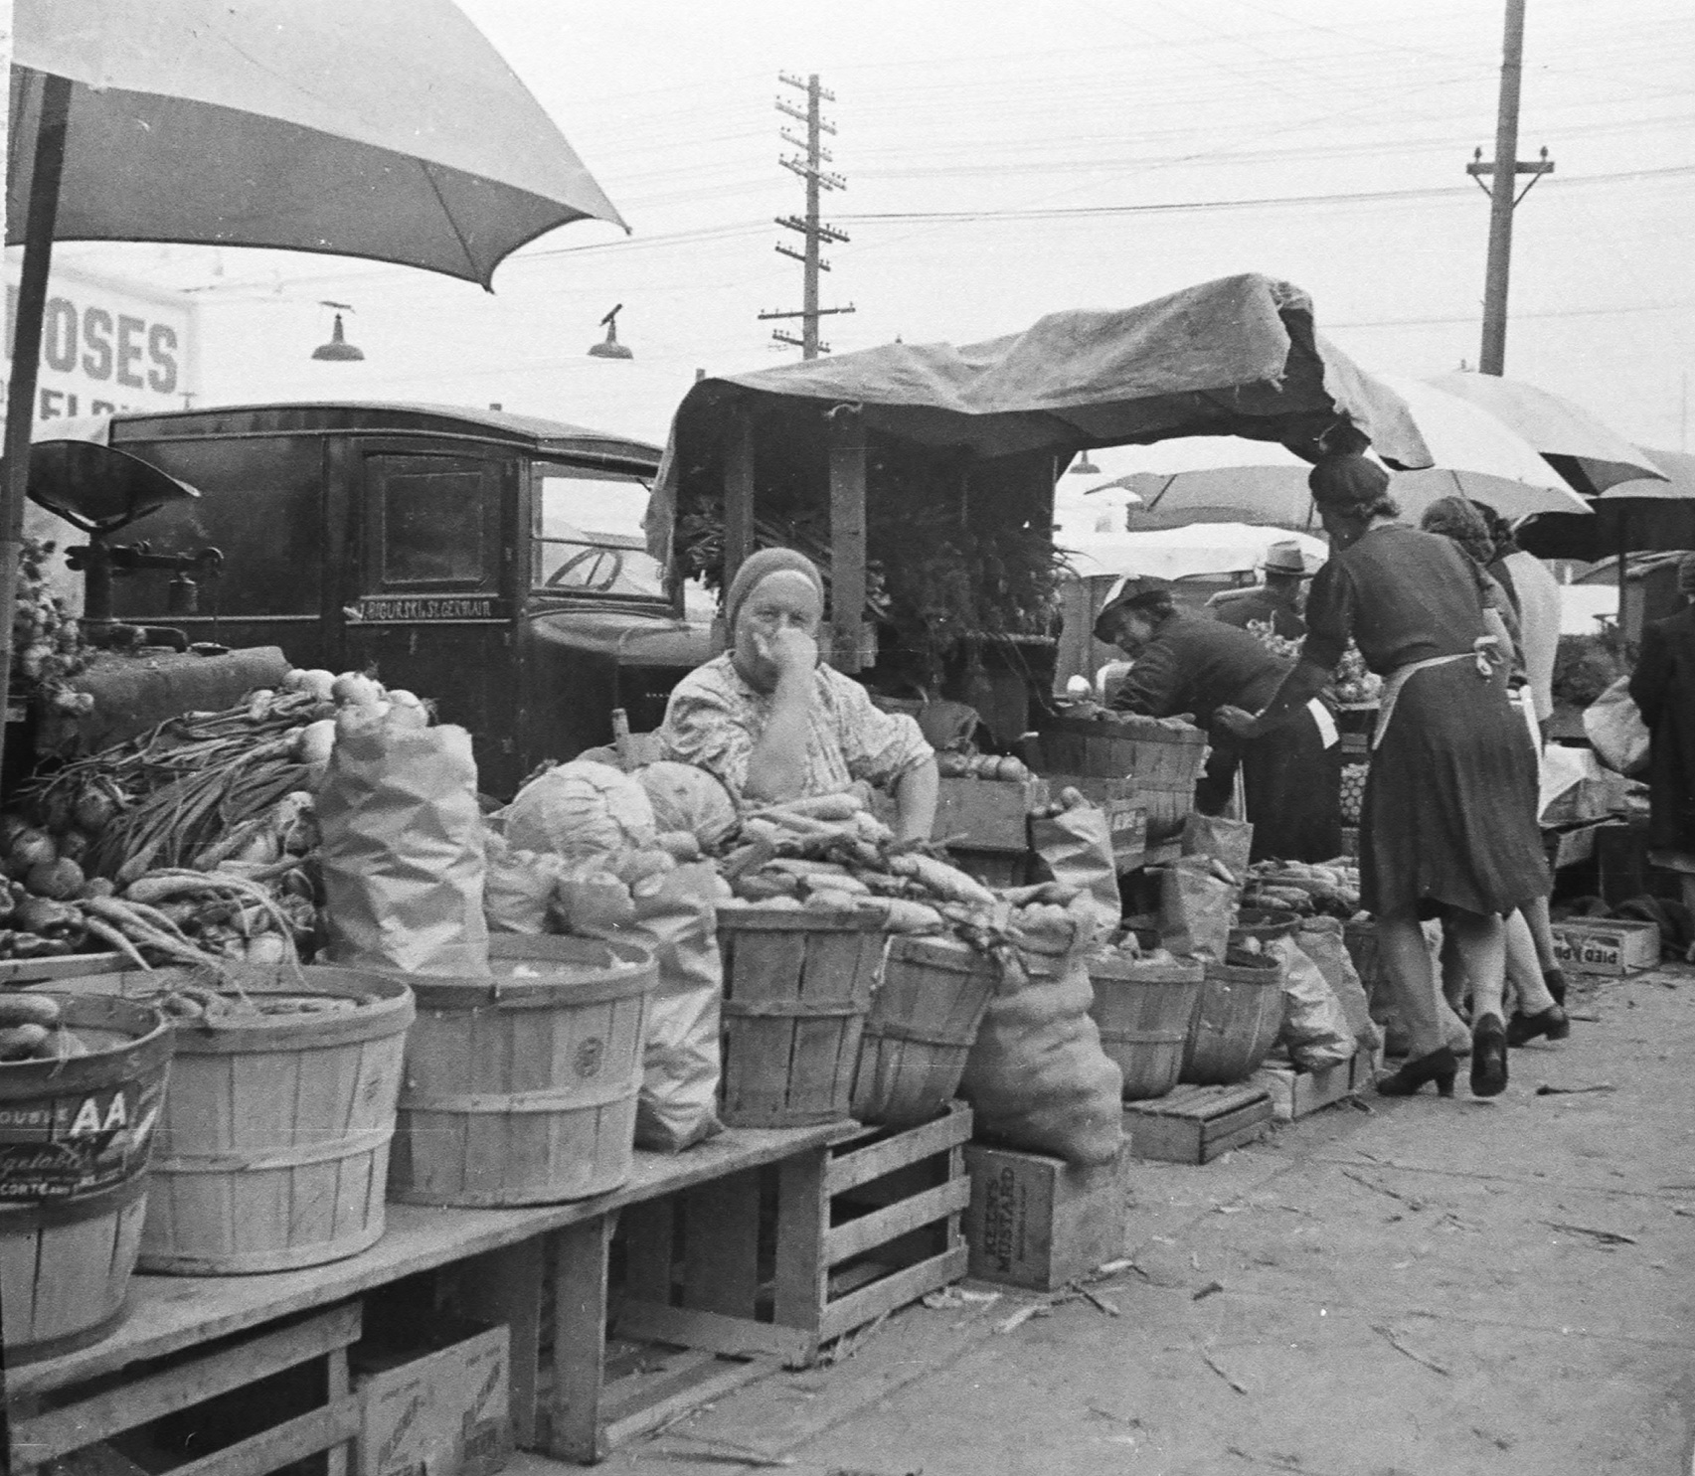

Slide 19
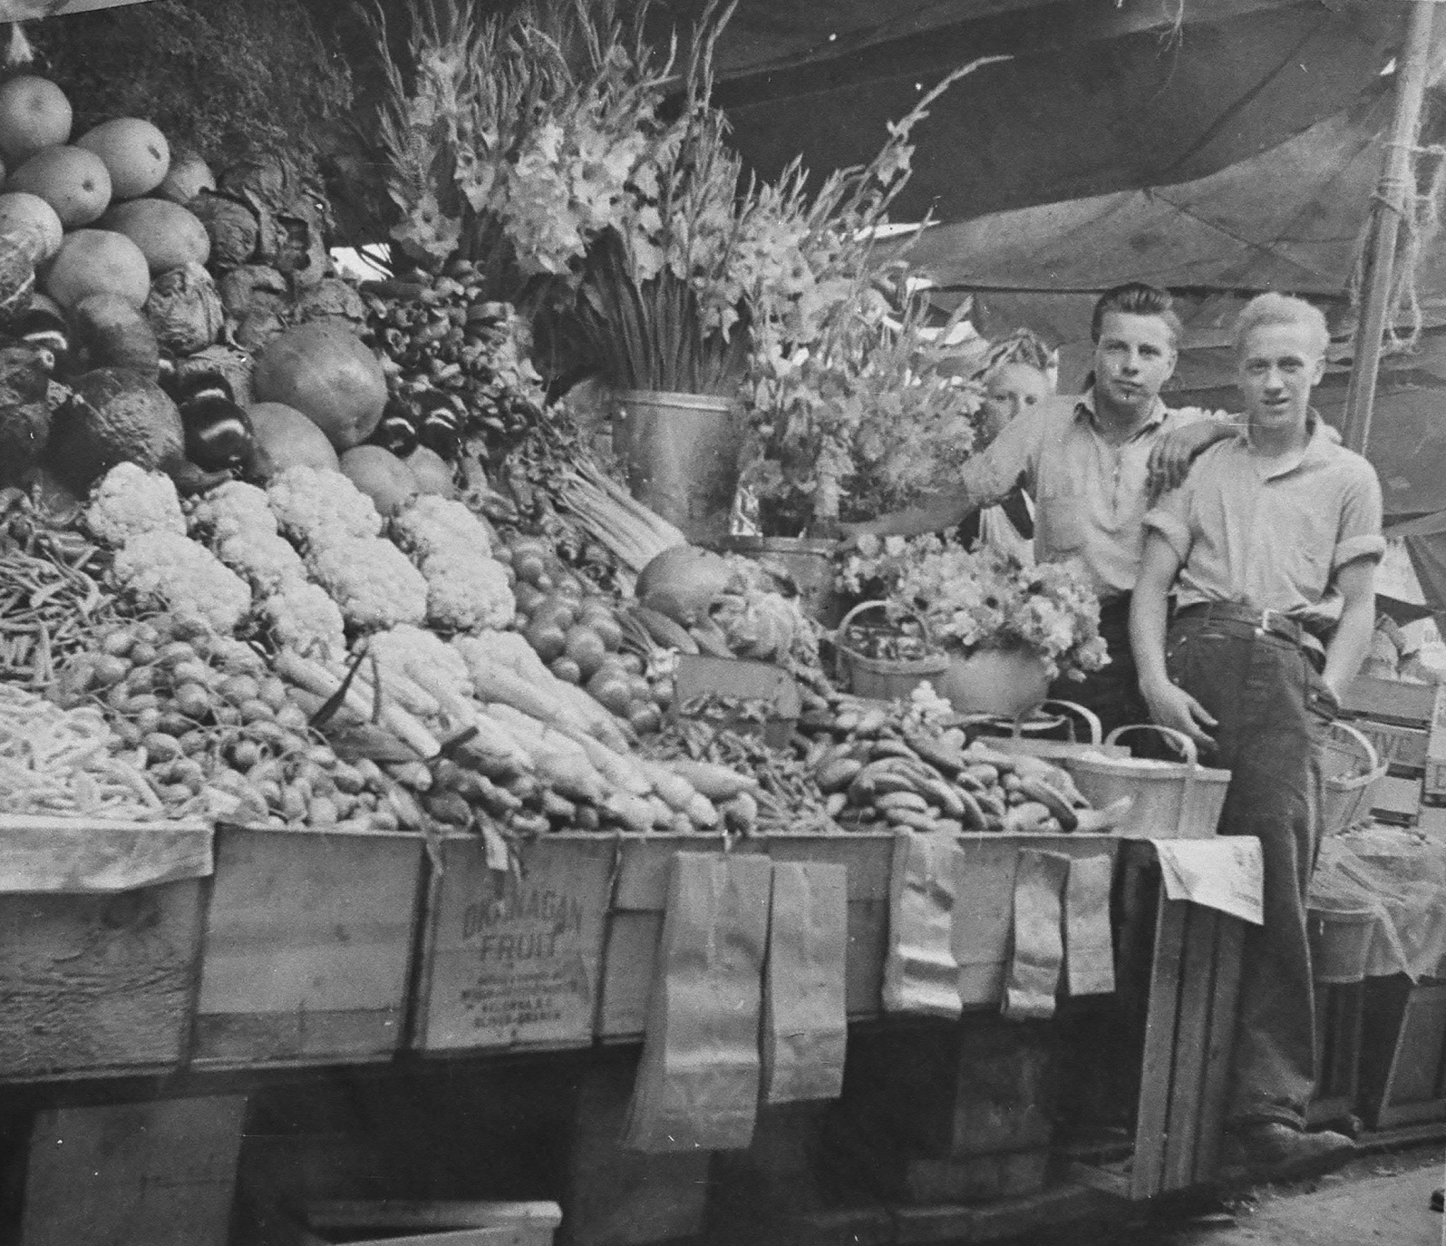

Slide 20
Notes:
Kuzminski stand 1946

Slide 21
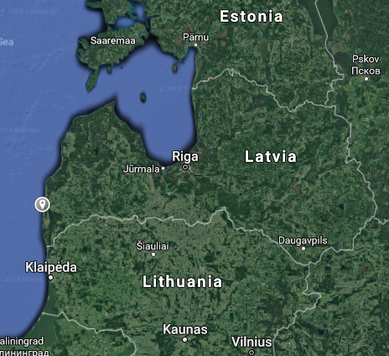
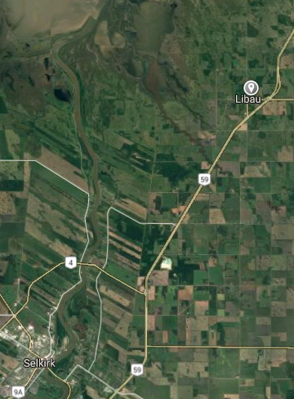
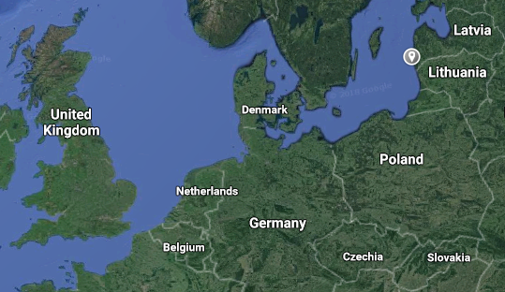
Libau

Slide 22
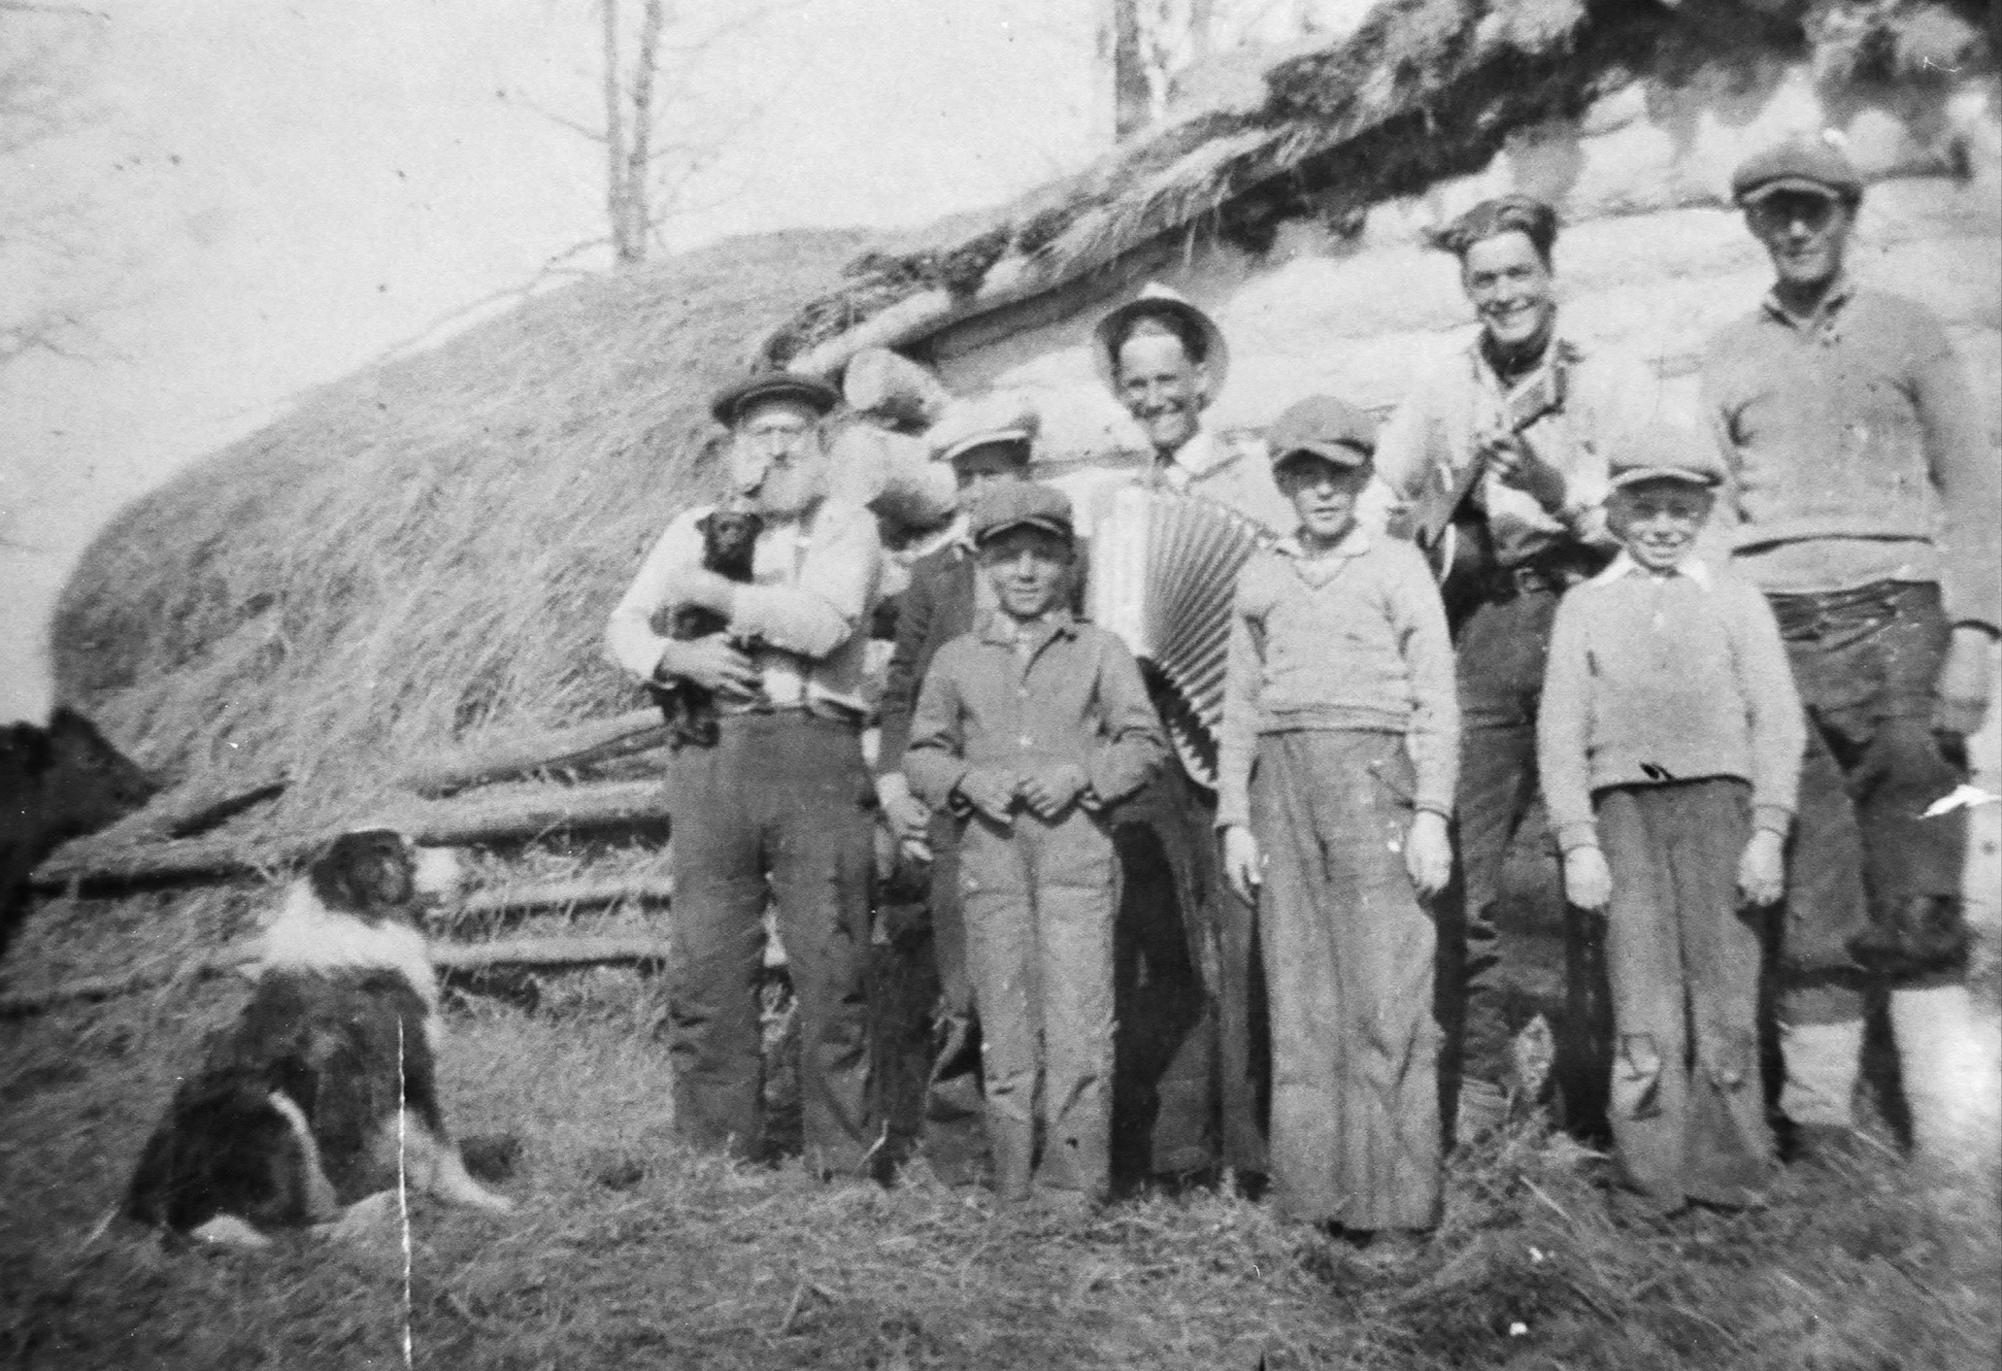
Notes:
Whittle’s Barn at Whittles Point, Libau

Slide 23
Notes:
Stacking Hay at Joe Gloss farm, Libau

Slide 24
The Schneider Commune
Inflation in Germany after the First
World War
Unworkable communal model at
Little Britain, 1927
Split up in 1928

Slide 25
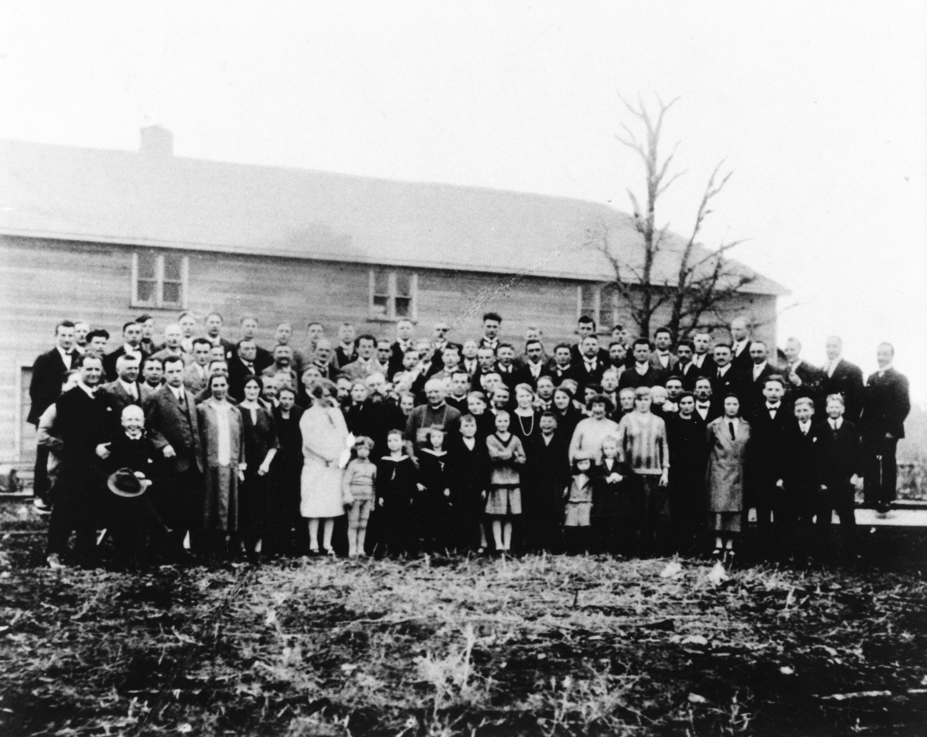
Notes:
Where everyone stayed until titles were granted

Slide 26
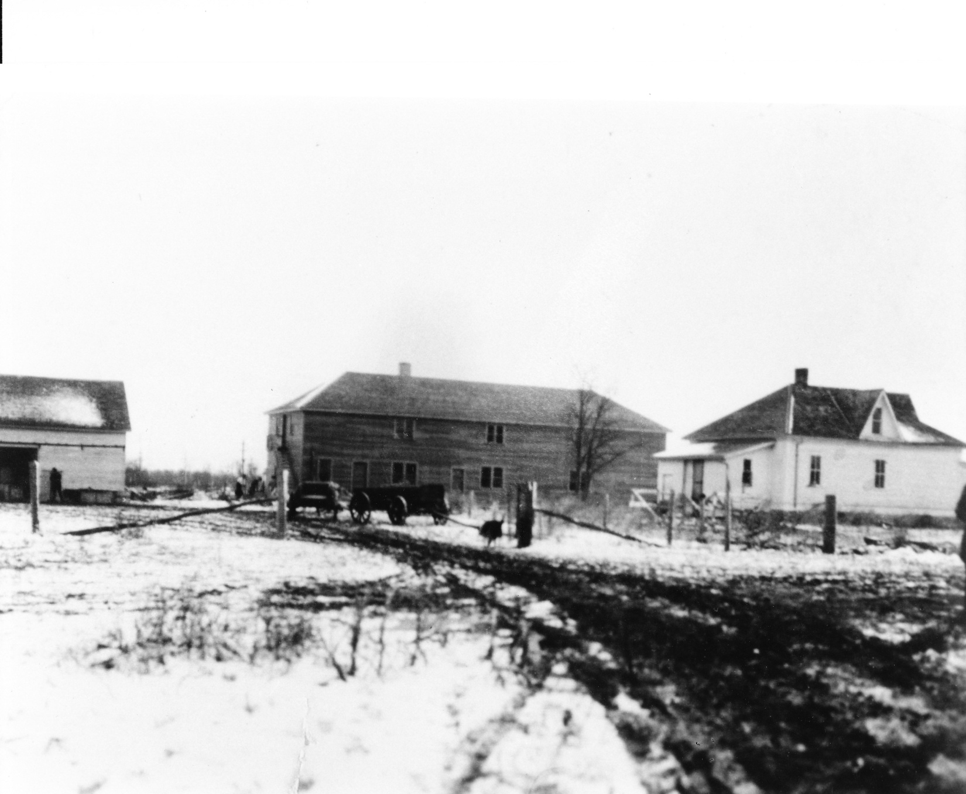
Notes:
Community buildings, 1927

Slide 27
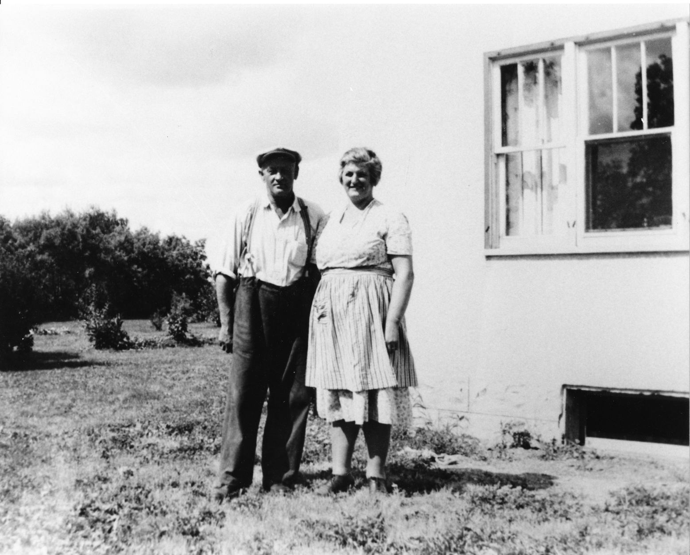
Notes:
Members of the community

